Slide 1
PCB Libraries: Packages, Symbols, and Devices
Dr. Steven Swanson
CSE176e/276e
swanson@cs.ucsd.edu

Slide 2
PCB Libraries
To use a part on a PCB, you need a library entry for it
Physical/mechanical information for the board
Logical/electrical information for the schematic
Mapping between the two
Metadata
A well-designed library, makes your life much, much easier.
There are lots of libraries are the internet
Some are good, some are bad, some a poor match for what we need.

Slide 3
Designing for Correctness
Building correct libraries can be hard
It’s very easy to introduce bugs in your library
It can be very hard to find bugs in your library.
Your goal is to make it as easy as possible to verify your library’s correctness
Copy/mimic the datasheet as much as you can
Pin names
Pin order
Part orientation
This minimizes errors and makes it easy to check

Slide 4
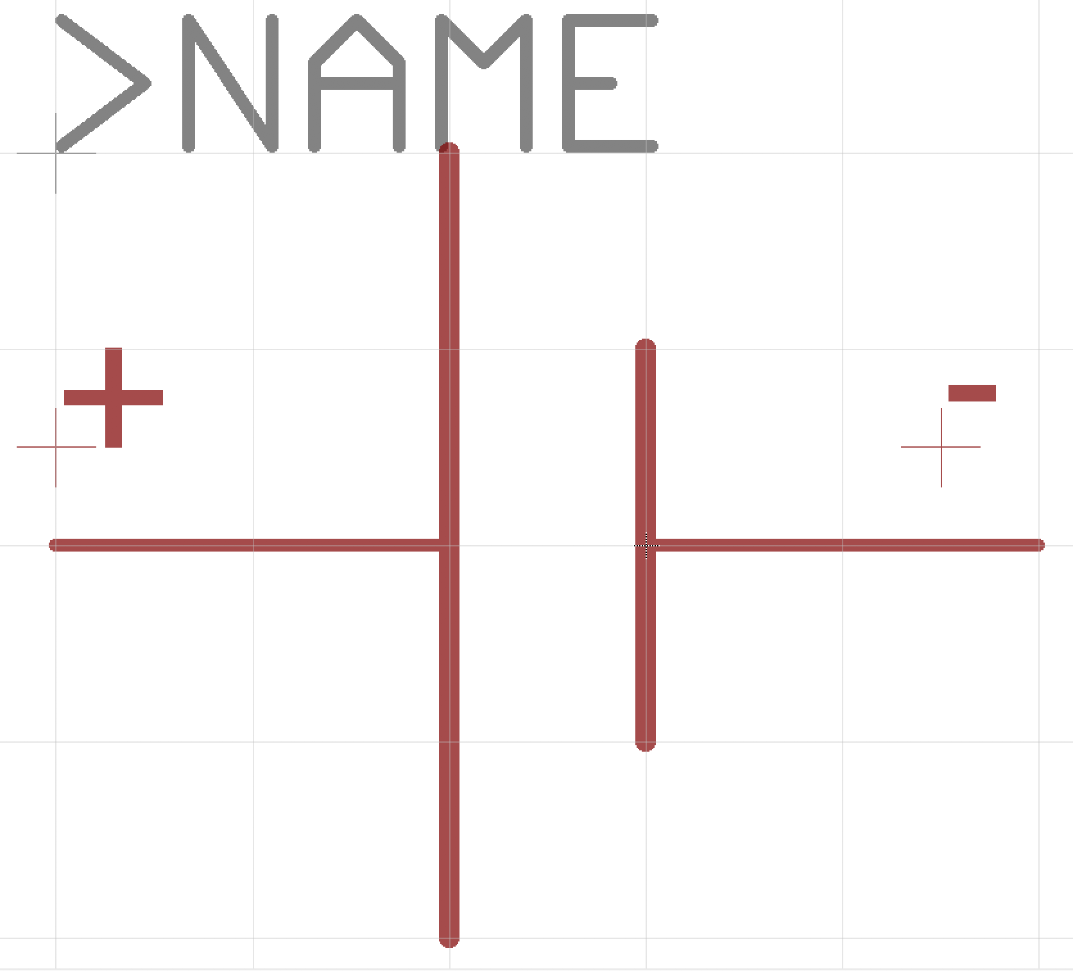
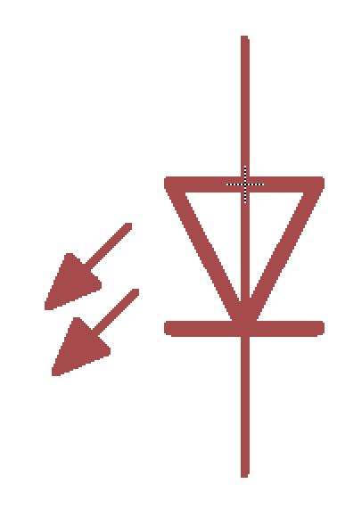
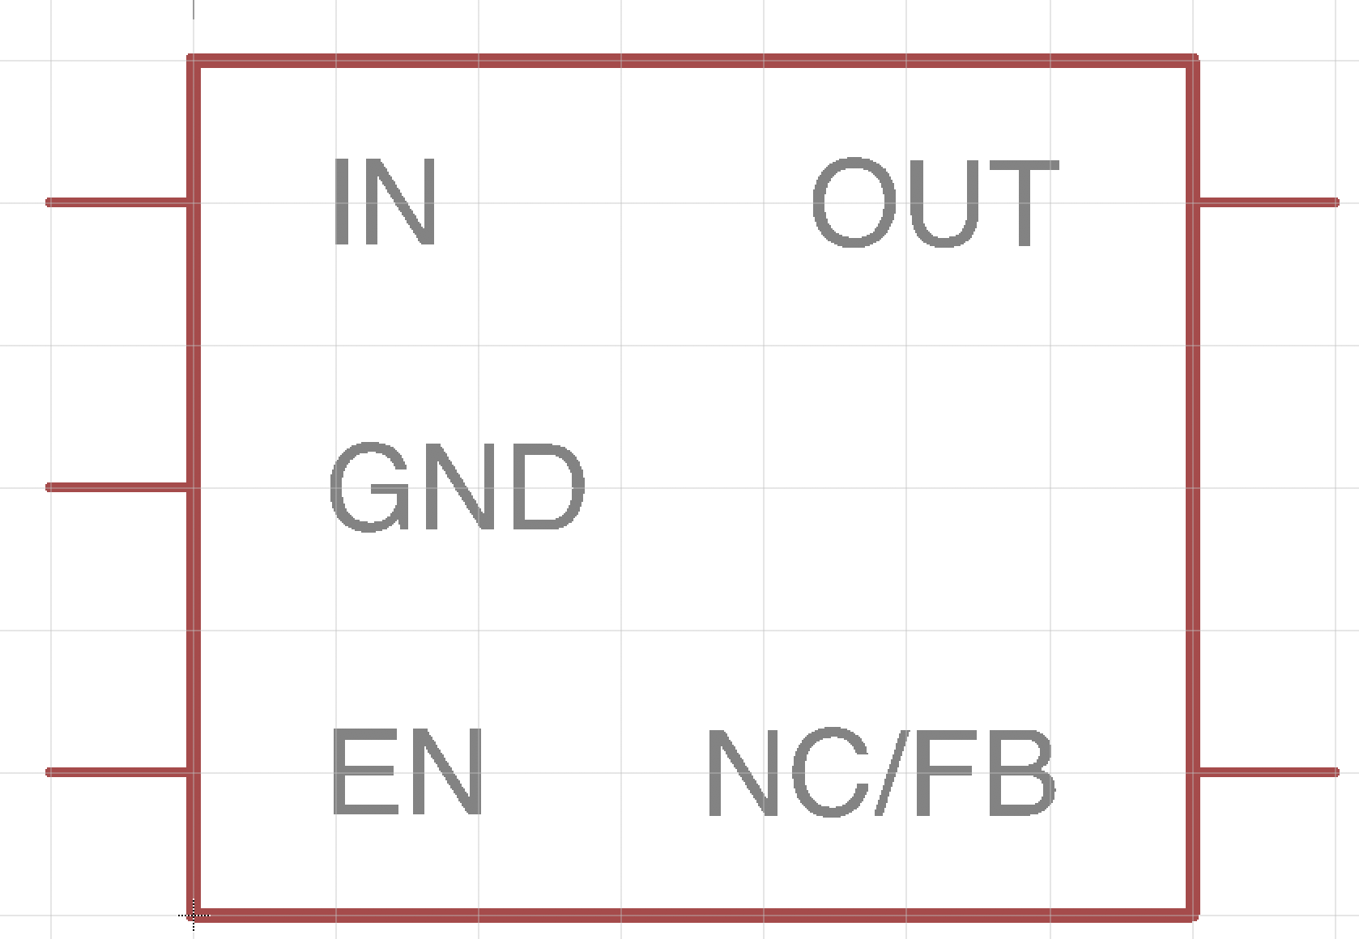
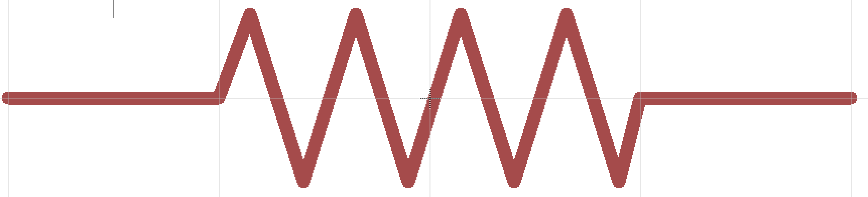
PCB Libraries: Symbols
Schematic representation of the component
Electrical connection points – “pins”
Generic symbols: resistors, capacitors, etc.
Specific symbols: e.g., Atmega128RF
Documentation, labels, etc.
Organized for ease of use and readability
Battery
Resistor
LED
Our voltage regulator

Slide 5
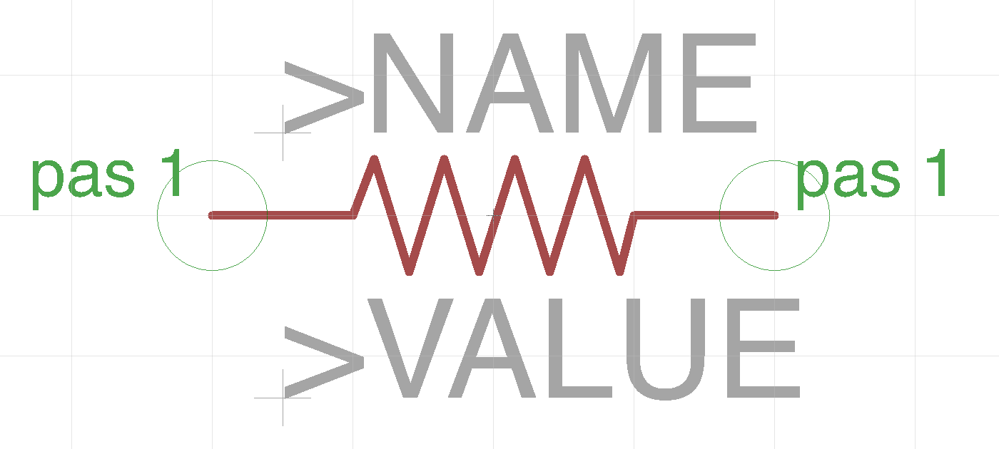
Example: A Resistor Symbol
Human-readable representation of the part
Has the standard resistor “zig zag”
Two ‘pins’
Pas 1
Pas 2
And place holders for documentation
>NAME – e.g. “R6”
>VALUE – e.g. “200Ohms”

Slide 6
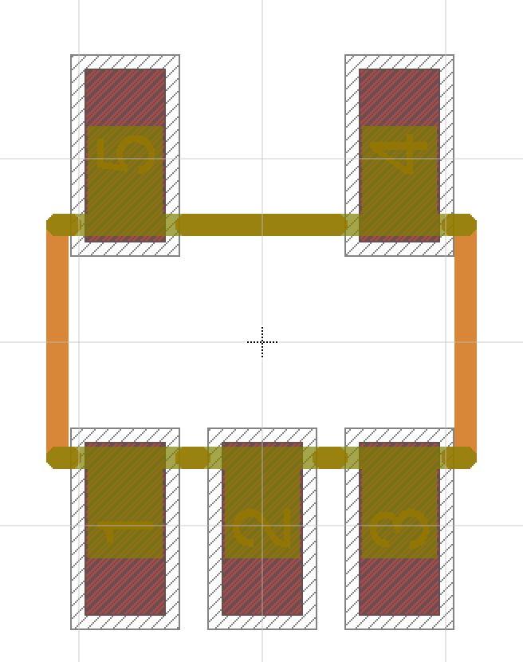
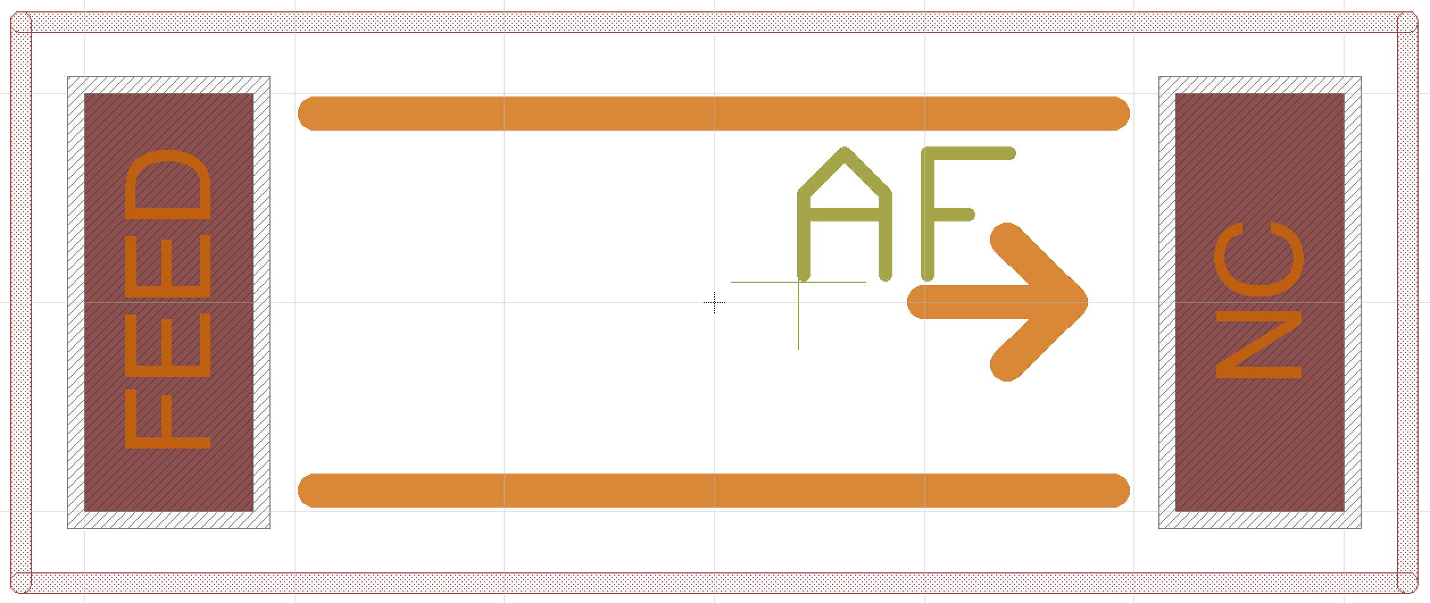
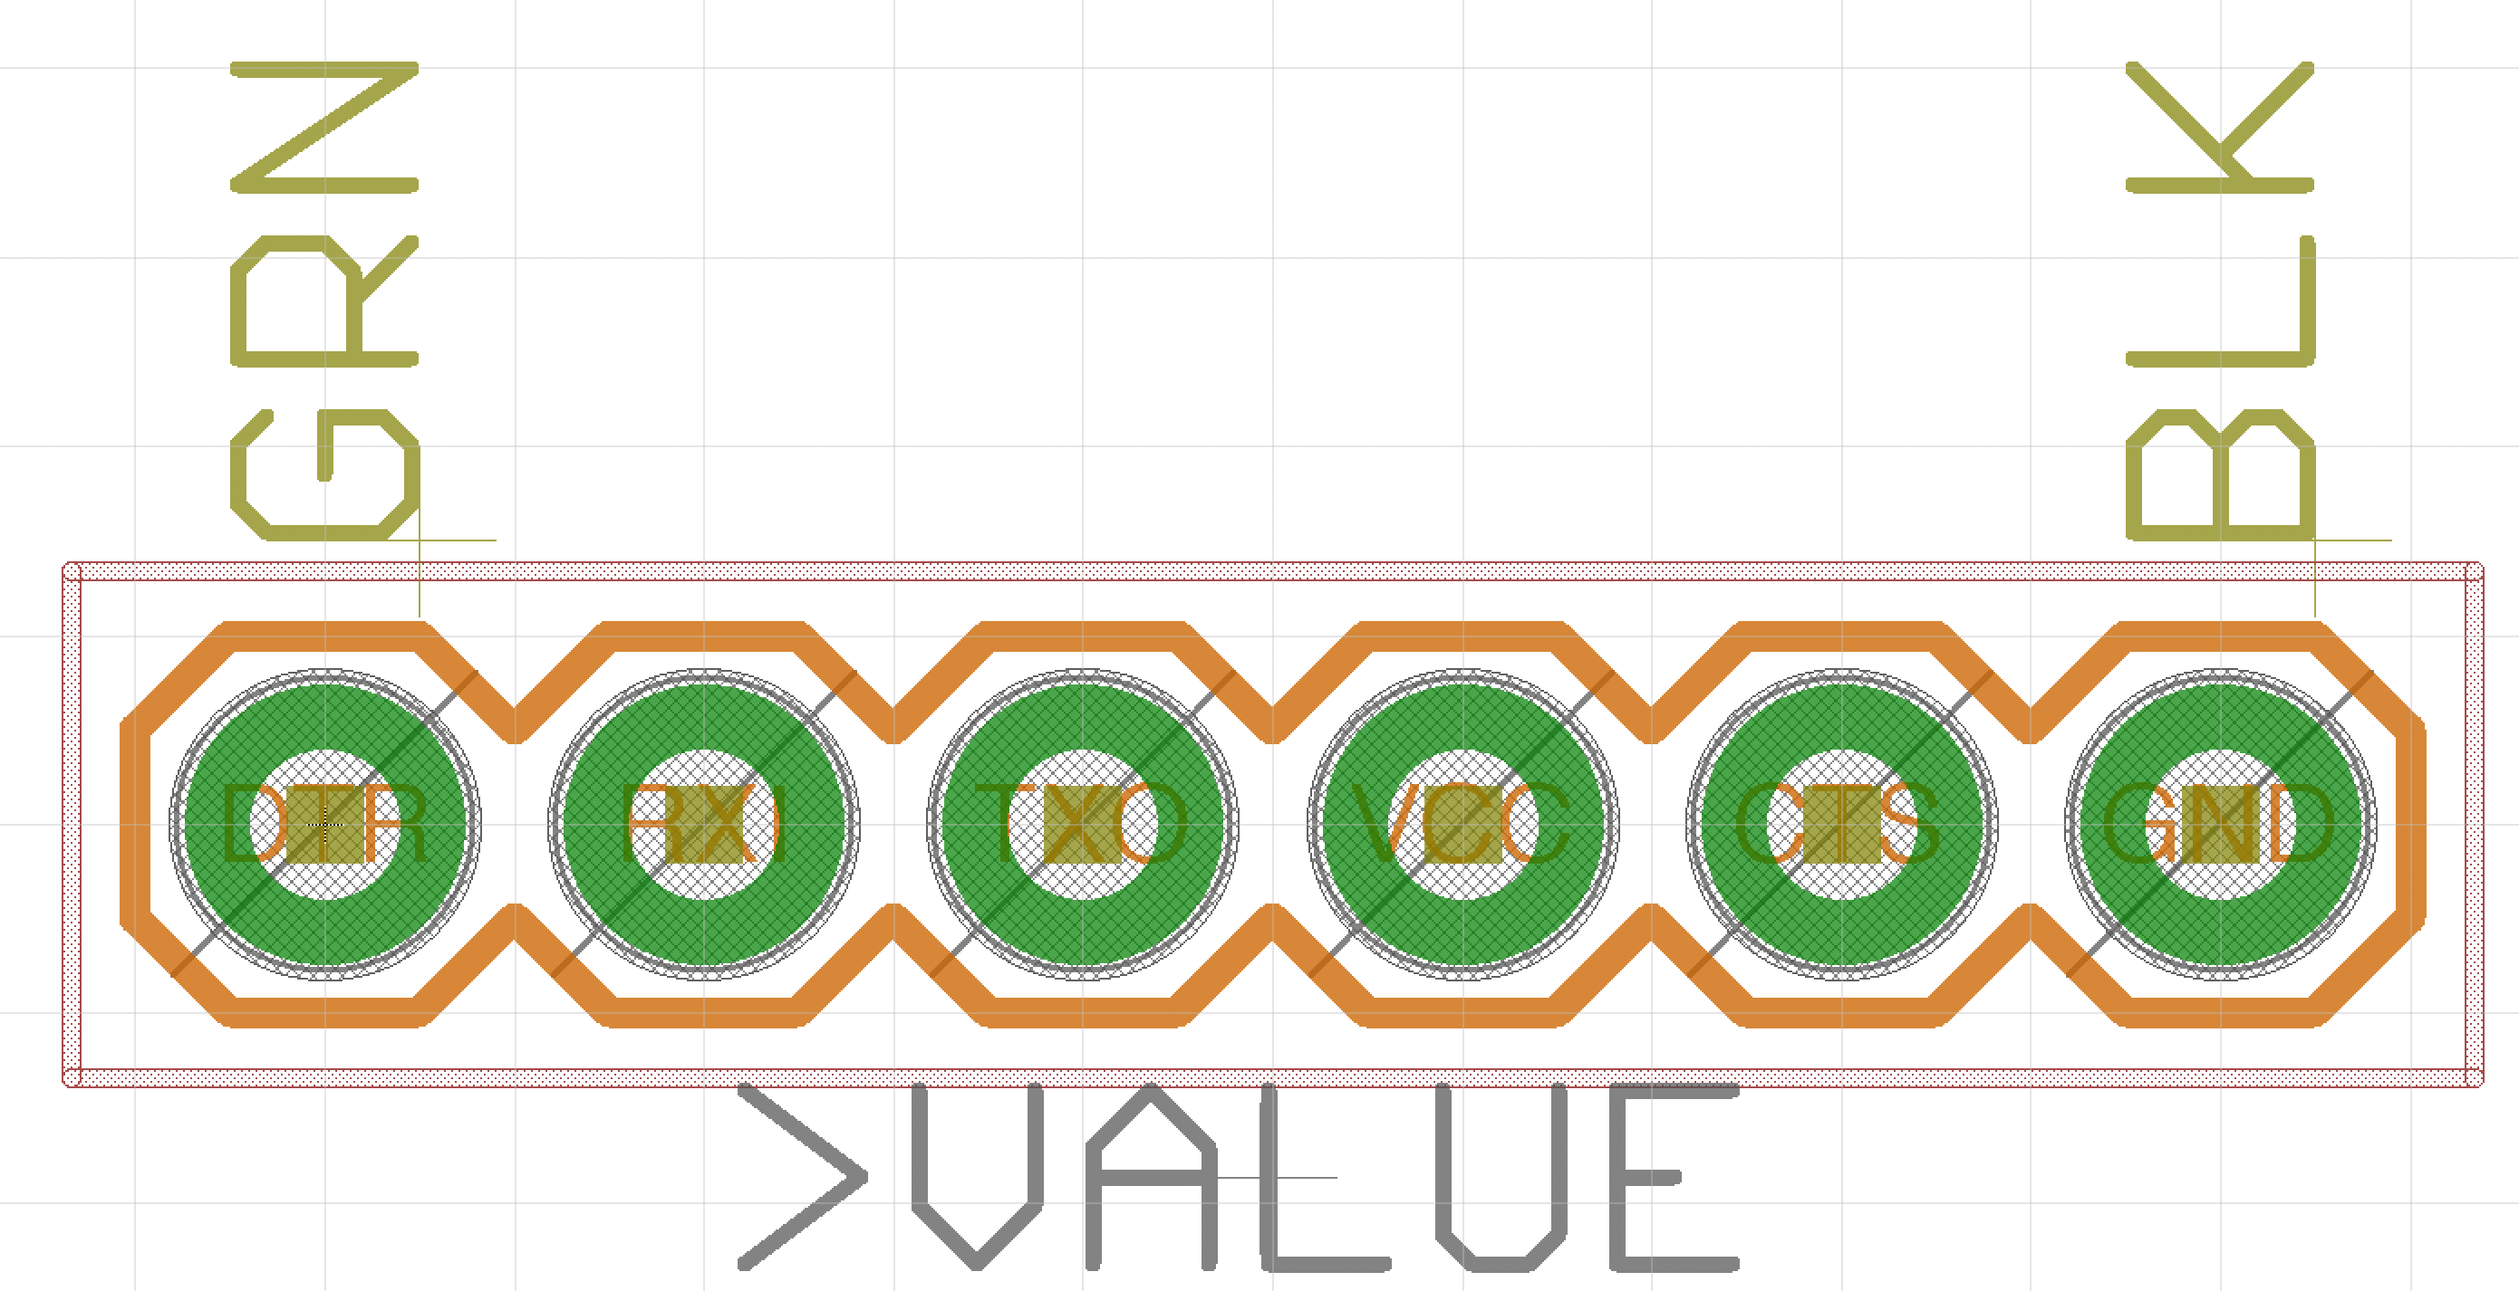
PCB Libraries: Packages
Mechanical description of the part
Electrical connections (i.e., pads and SMDs)
”keepouts” (i.e., the space the occupy)
Documentation (e.g., an outline to guide placement, reference designators, user documentation)
Generic packages
e.g., 0805 Resistor (there are 1000s of kinds of these)
Specific packages
e.g., Atmegat128RF (there’s just one kind)
An “chip” antenna
Standard SOT23 package
Programming Header

Slide 7
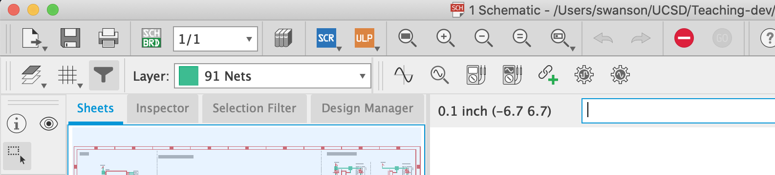
The Eagle Command Line
You can use your mouse to select tools in eagle, but it’s slow.
Faster is to type commands using the command line
You can mouse of the tool pallet to get the command name
e.g., “move”, “copy”, ”info”, …
Then type ‘help <name>’ for help.
Or just type the name to select that tool.
This will save you hours over the course of the quarter.

Slide 8
Units
Units
We will mostly use mm in this class.
1mm is about 40mils (39.3700787, actually)
1in is exactly 25.4 mm.
Keep an eye on your units.
Exceptions
Eagle schematic symbols and schematics use inches
Lots of tutorials, documents, etc. use mils (1/1000 of an inch) or inches.
Breadboards and headers are typically 0.1” spacing (2.54mm)
Mars Climate Orbiter

Slide 9
Working with Units in Eagle
Use the “grid” tool (or command) to set grid eagle will “snap” to.
‘grid mm’ -> switch to mm
‘grid 1’ -> make the grid 1 of the current unit

Slide 10
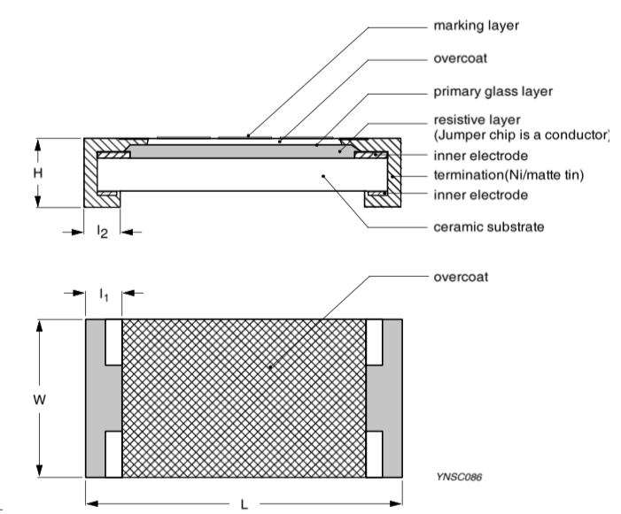
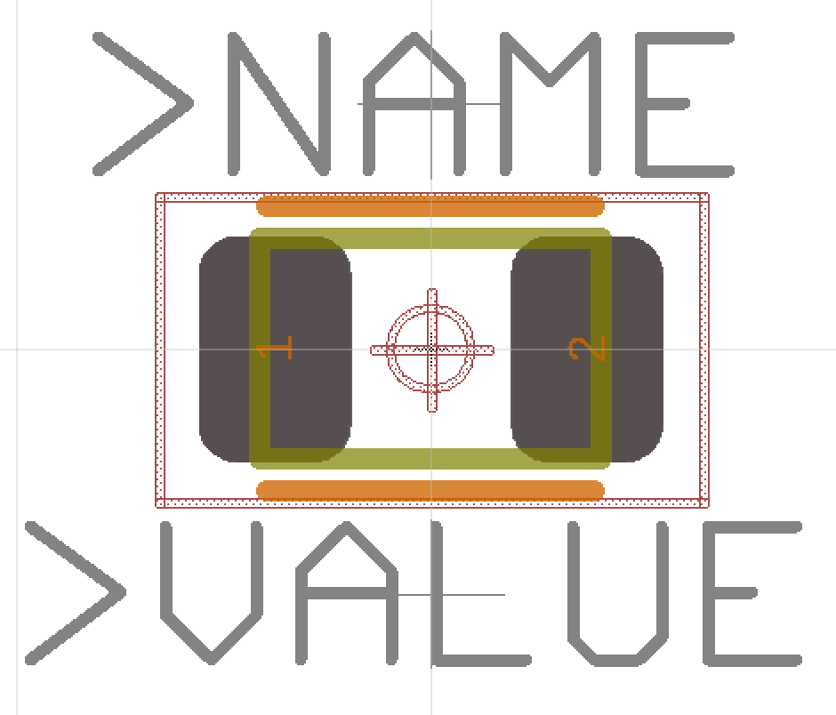
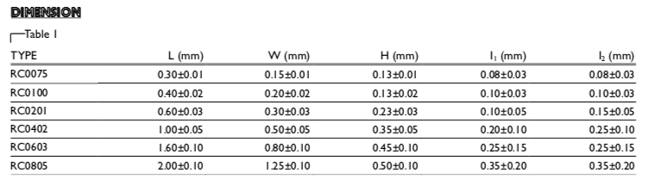
Example: A Resistor Package
Yageo RC Series SMD resistor
Package: 0805 (8mm x 5mm)
Pads
Extend out 1mm or so for easy soldering.
Keep out area (courtyard)
Where other parts should not be
Yageo makes these in many sizes 0075 (so tiny!) to 0805

Slide 11
Anatomy of a Package (Resistor)
Pins
Ex. “1” and “2”
Outline
In tDocu (gold)
Matches part shape precisely
Orientation/placement guidance
in tPlace (orange)
Varies by part.
Name
In tNames
Magic value “>NAME”
See lab for font size
Value
In tValues
Magic value “>VALUE”
See lab for font size
Keepouts
In tKeepout
Red shaded
Documentation
In tPlace
Other useful items

Slide 12
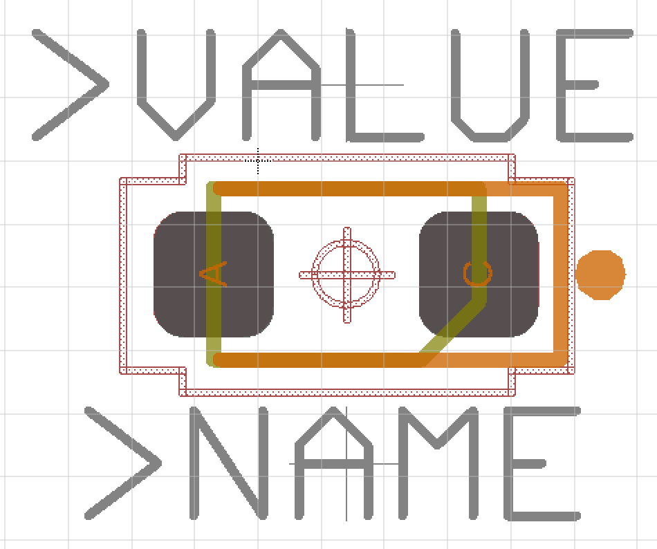
Anatomy of a Package (LED)
Same basic parts as a resistor.
But LEDs are not reversible.
Polarity marking
in tPlace (orange)
Mark pin 1

Slide 13
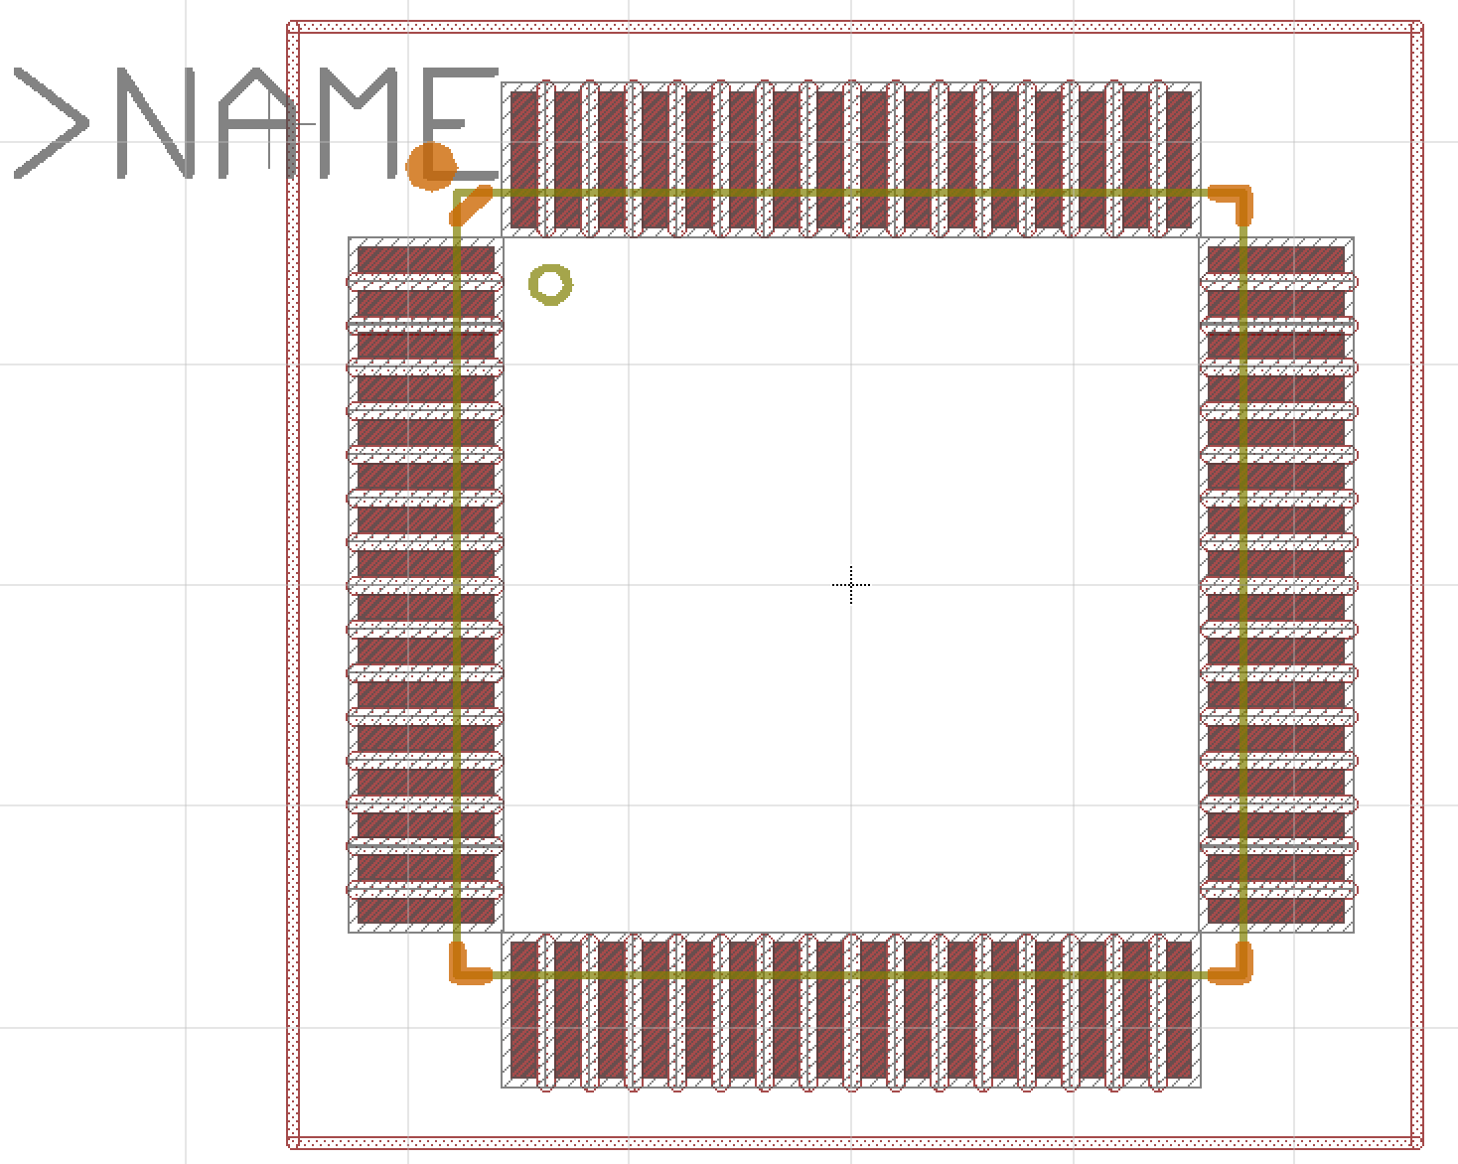
Anatomy of a Package (Microcontroller)
Same components, just more pins

Slide 14
PCB Libraries: Devices and Variants
There is one “device” in a library for each kind of electrical component
Resistor
Capacitor
AtmegaRFA128 microcontroller
Each device can have several “variants” (Eagle term)
There’s one variant for each specific electrical component
Yageo AC0603JR-07510RL (510 Ohm resistor)
Yageo AC0603JR-072K2L (2.2KOhm resistor)
…
Variants are what you add to your design.

Slide 15
PCB Libraries: Devices & Variants
Devices map between
1 symbol
1 or more variant
A variant has
Name
Package
Pin mapping
Metadata
“attributes” -- e.g., manufacturer, part number, resistance, capacitance
Name prefix for reference designators -- e.g., the “R” in R1, R2, etc.
Does it have a “value”? (e.g., a resistor’s value is its resistance, but a microcontroller doesn’t have a value)

Slide 16
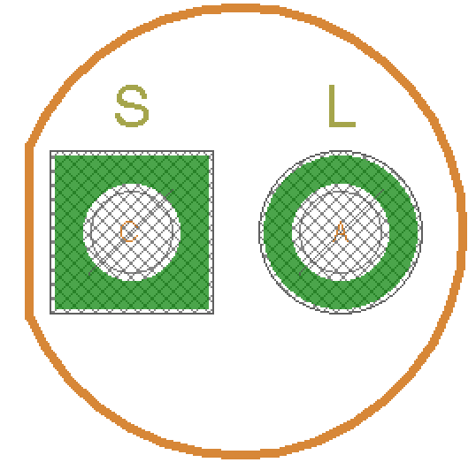
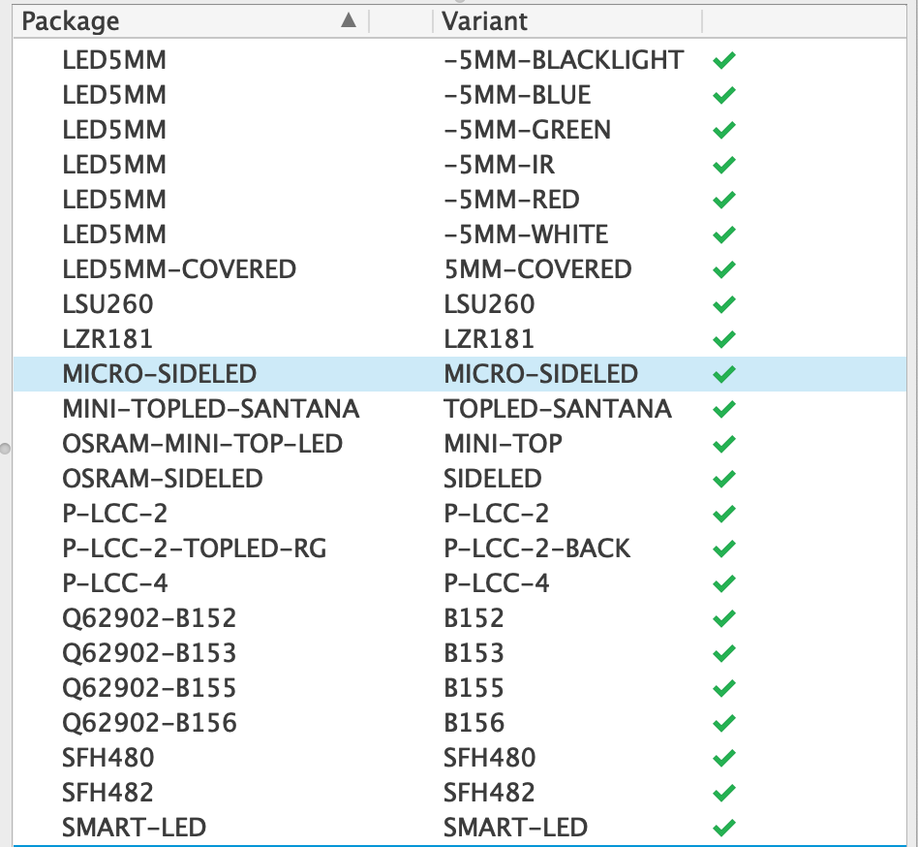
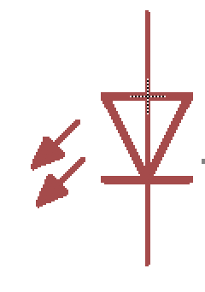
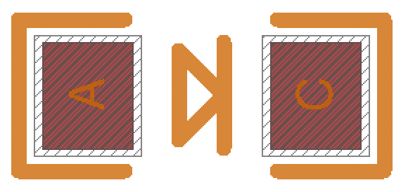
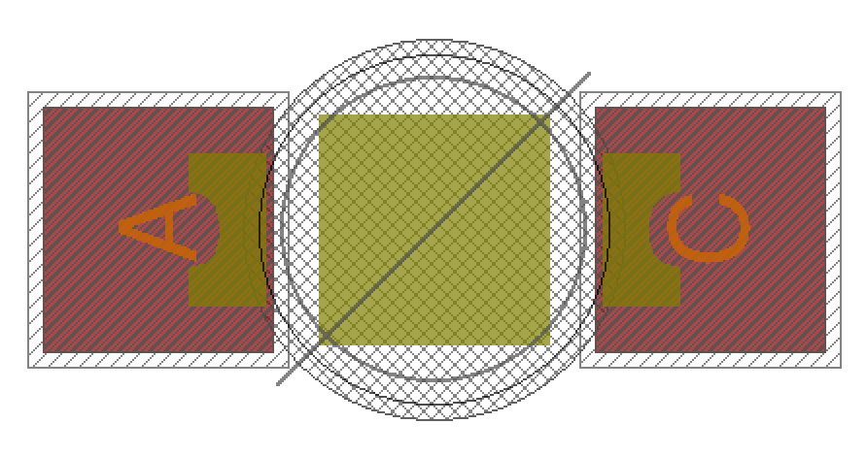
Device Example: LED
One Symbol
Many Packages
Many more variants

Slide 17
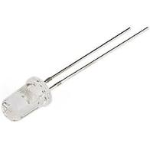
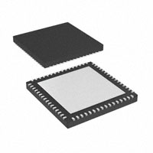
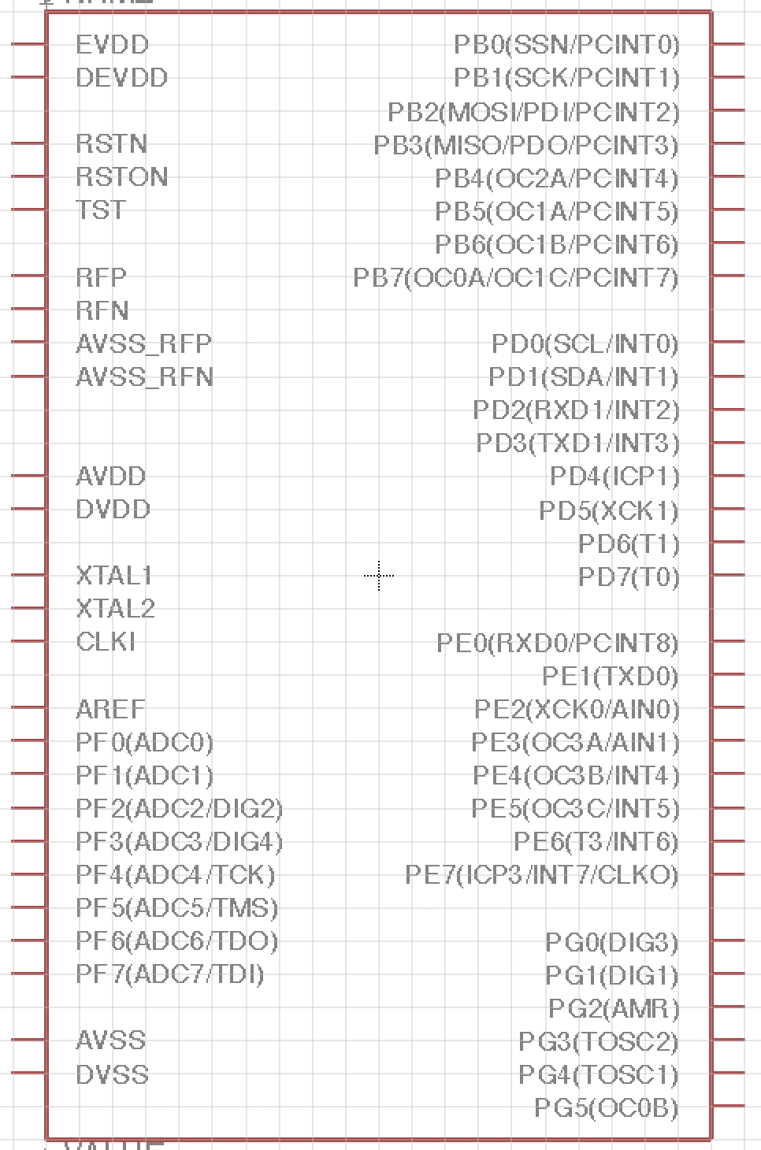
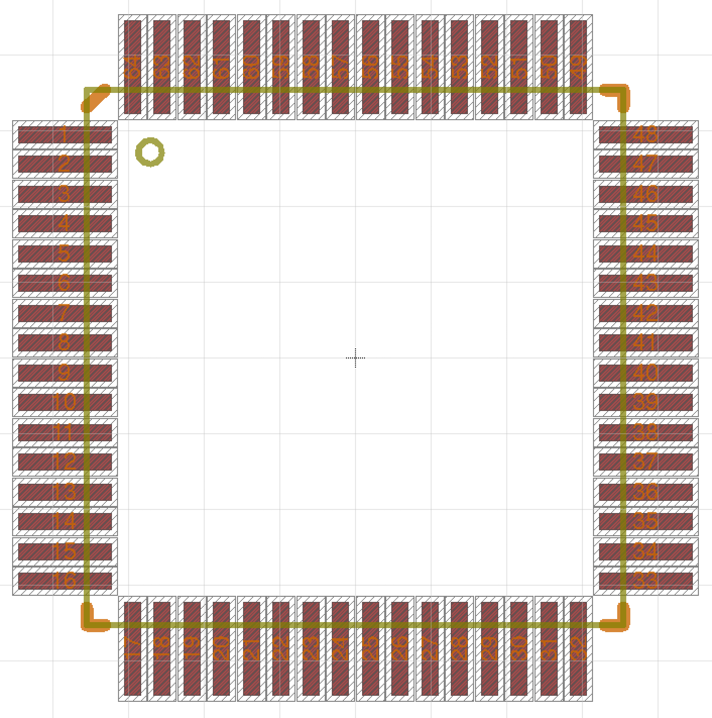
Symbol-to-Package Mapping & Metadata
Physical part
Attribute | Value
Part Number | XAU252ae-22
Manufacture | LED Inc.
Package
Symbol

Slide 18
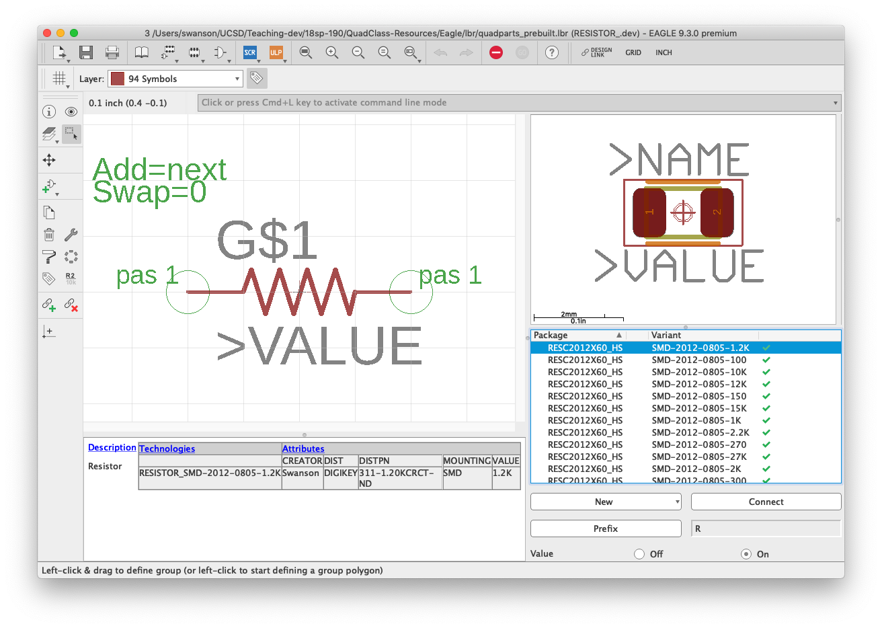
Example: A Resistor

Slide 19
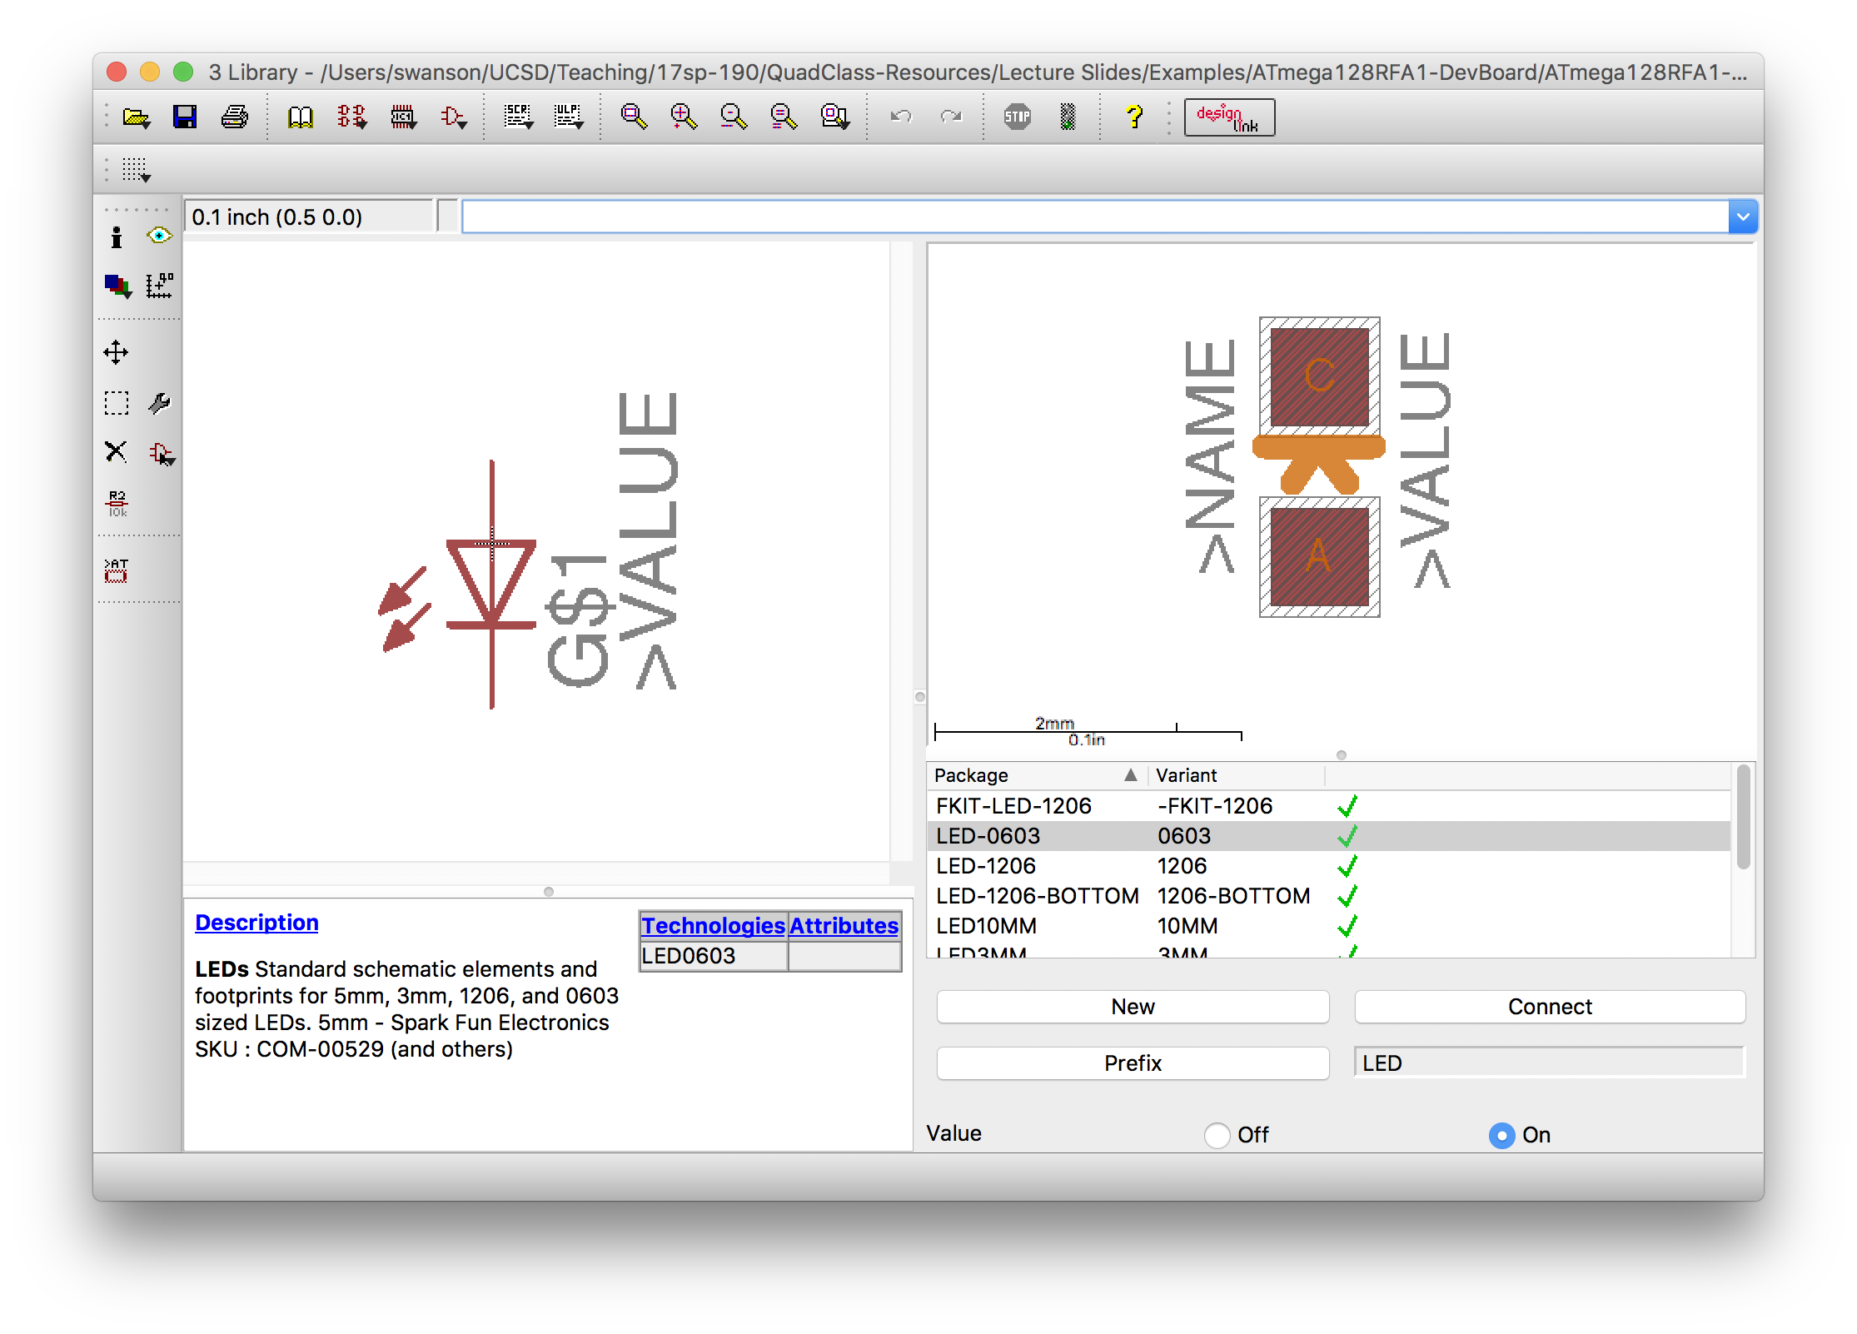
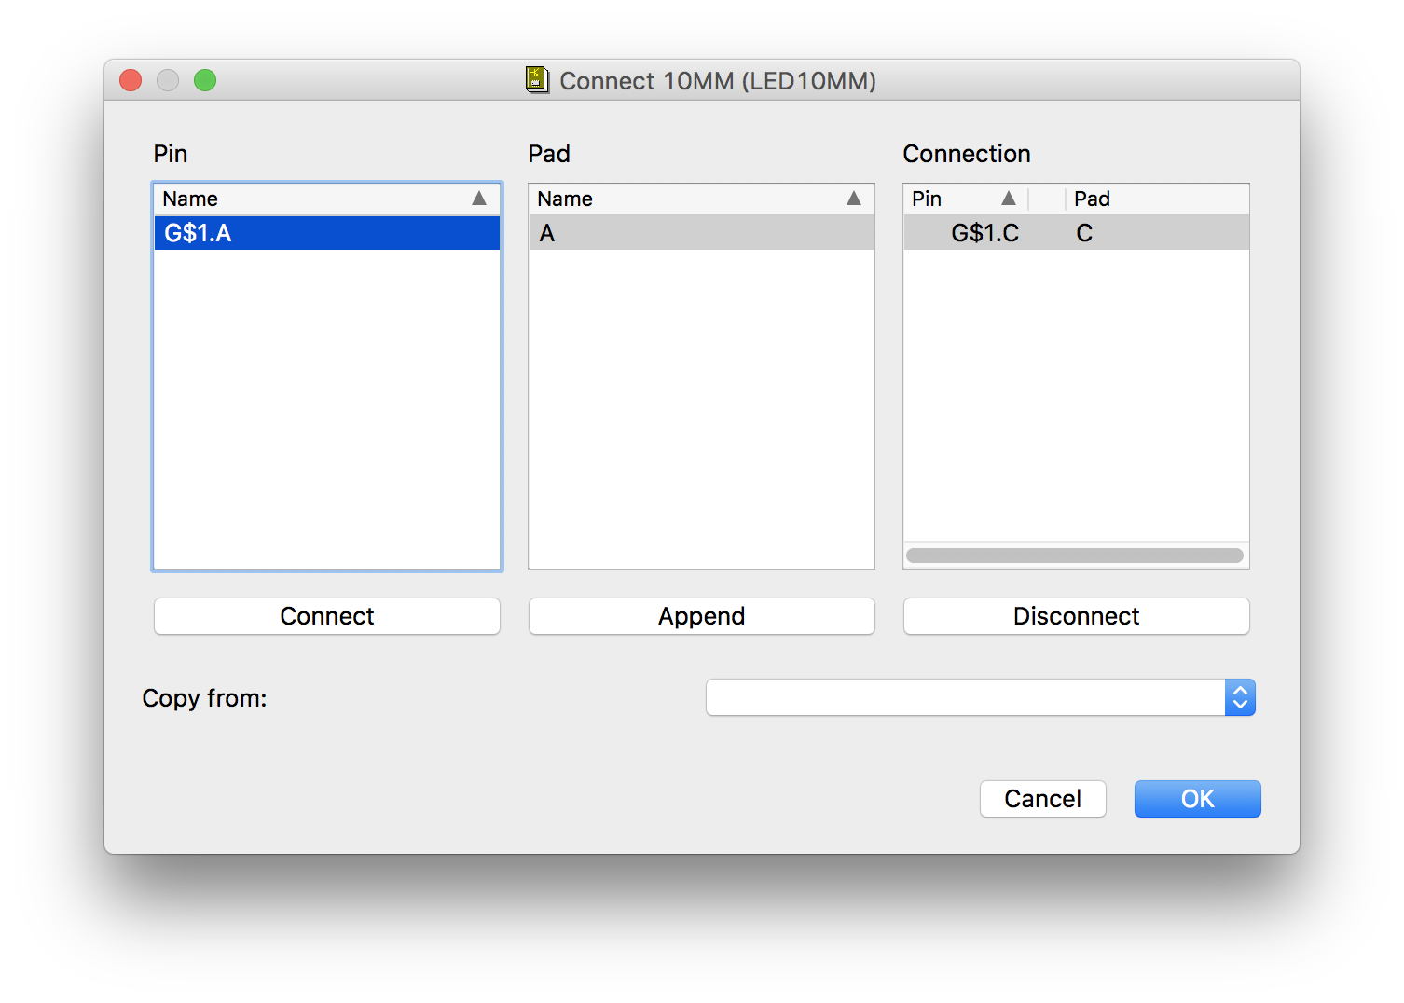
Connecting Symbol Pins to Package Pads

Slide 20
PCB Libraries: Packages, Symbols, and Devices
Dr. Steven Swanson
CSE176e/276e
swanson@cs.ucsd.edu

Slide 22
Notes
Meeting time remains 11-12:30
Depending on demand, we will have lab hours 3-4:30
Office hours queue form up. Check piazza
Remember to provide links to your checks in piazza questions.

Slide 23
Project Overview
Dr. Steven Swanson
CSE176e/276e
swanson@cs.ucsd.edu

Slide 24
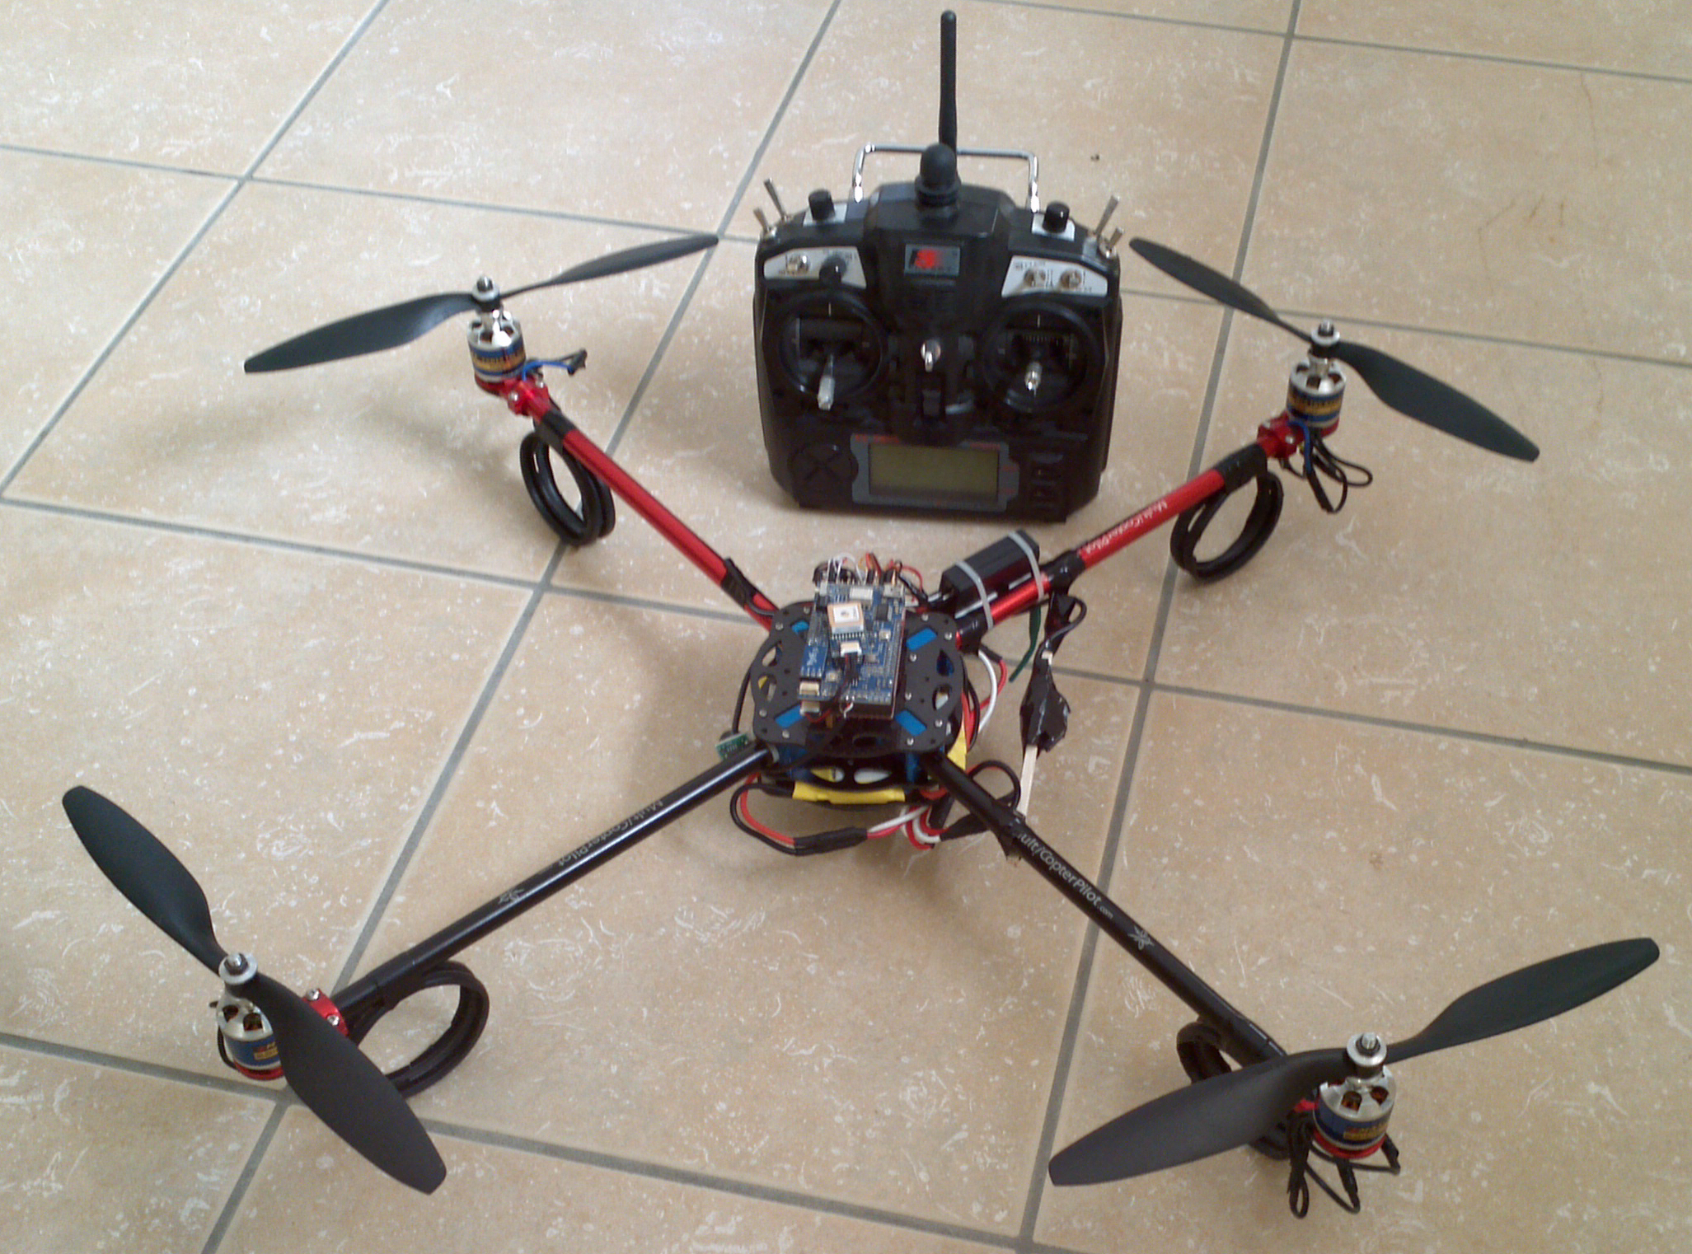
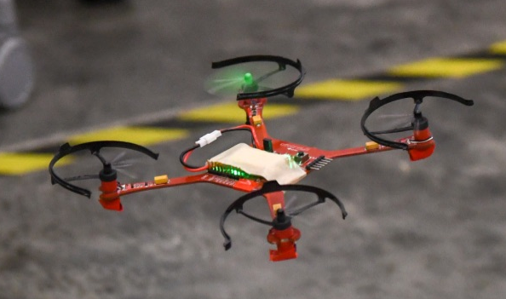
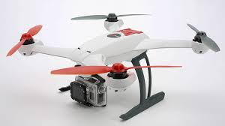
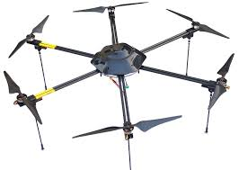
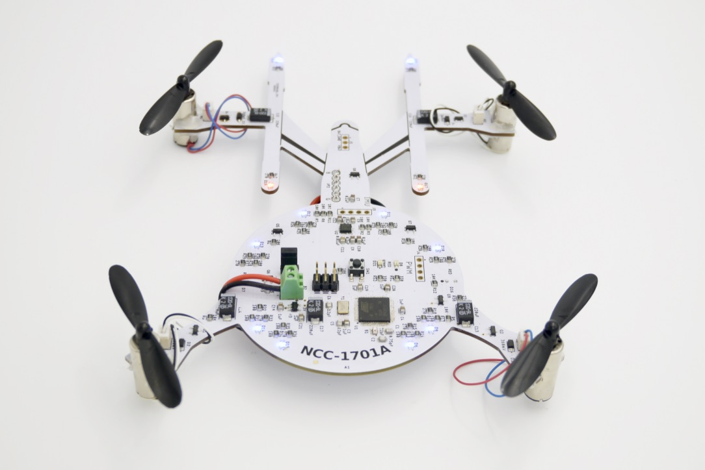
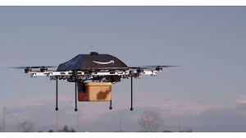

Slide 25
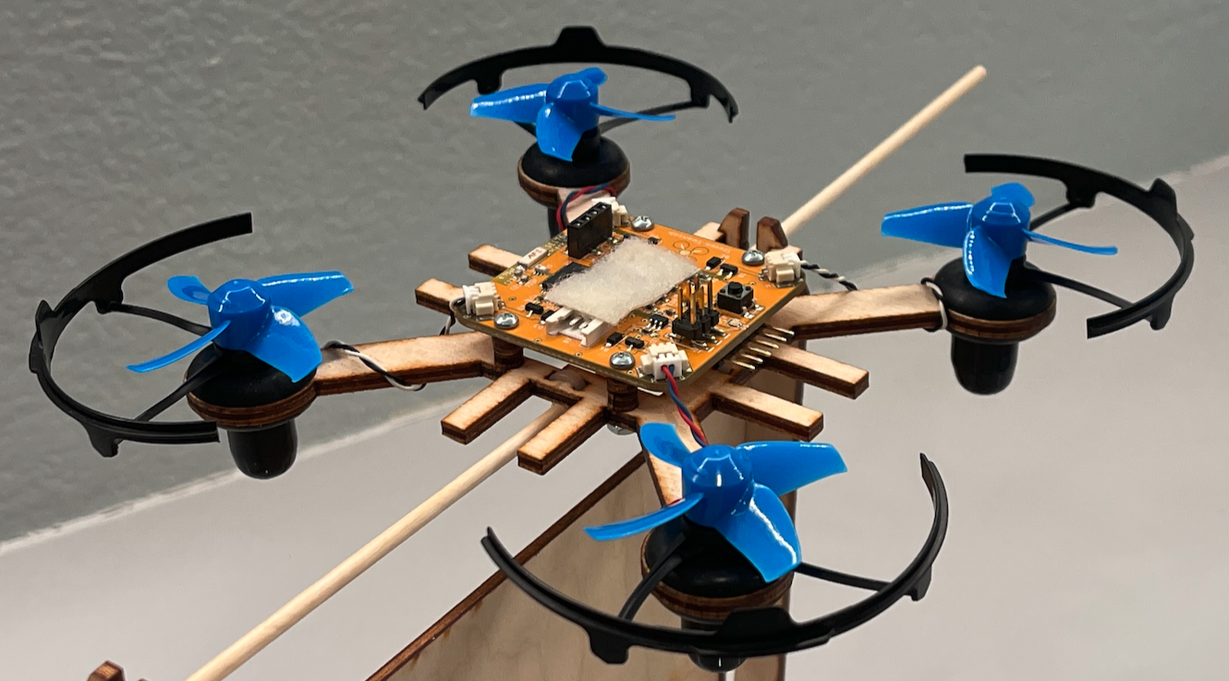
Multirotor Aircraft Components
Airframe
Structural support
Plastic, aluminum, wood, or PCB (fiberglass)
Motors
Lift, movement, and control
Brushed DC motors for small craft
Brushless brushless DC motors for large craft.
Inertial Measurement Unit (IMU)
Sensing the aircraft’s orientation and movement
Gyroscopes and accelerometers.

Slide 26
Multirotor Aircraft Components
Computing resources (microcontroller/processor)
To run the flight control software
Manage communication
Flight control software
Provides stability using the IMU and motors
Converts pilot commands to motor outputs
Radio
For receiving command
Returning telemetry.
Power supply
Lots of power for the motors
Carefully regulated power for the IMU and micro controller.

Slide 27
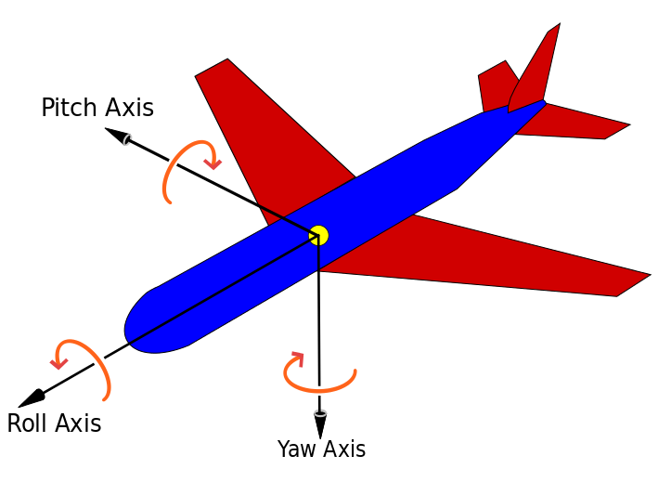
Principle Axes of an Aircraft
Pitch – leaning front or back
Roll -- leaning side to side
Yaw – rotating

Slide 28
Motor Configurations
“multirotor” is more accurate that “quadcopter”
There are always an even number of motors
Half spin clockwise
Half spin counter-clockwise

Slide 29
Controlling Pitch
Pitch forward
More thrust to the rear
Less to the front
Quad moves forward
Pitch backward
Less thrust to the rear
More to the back
Quad moves backward
Net torque is constant

Slide 30
Controlling Roll
Pitch Left
More thrust to the right motor
Less to the left
Quad moves to the left
Pitch Right
More thrust to the left motor
Less to the Right
Quad moves to the right
Net torque is constant

Slide 31
Controlling Yaw
Rotate CCW
More thrust to the CCW motors
Less to the CW
Rotate CW
More thrust CW motors
Less to the CCW
Net thrust is constant

Slide 32
Quadcopters (and the Environment) are Imperfect
Motors are not perfect
Manufacturing differences
Electrical differences
Propeller imperfections
Air currents will move the quadcopter.
Turning on all motors the “same” amount
Leads to imbalanced torque and uneven thrust.
A crash is inevitable
This is “open loop” control

Slide 33
Closing the Loop for Controlled, Stable Flight
Quadcopters sense the orientation
IMU – Inertial Measurement Unit
Measures pitch, roll, and yaw
The flight computer, adjusts motor outputs to achieve a target orientation
Level – stationary flight
Pitched forward – fly forward
etc.
The target can be set via a remote to control flight.

Slide 34

Open vs. Closed Loop Control

Slide 35
In Summary: Flight Requirements and Our Labs
Requirement | Hardware | Software | Manufacturing
Driving the motors | Motors, battery, airframe, etc. Building The Quadcopter Schematic Laying Out The Board | Analog pin output Programming The Hardware
Providing a target orientation (via the remote) | A radio, a remote control Building The Quadcopter Schematic Laying Out The Board | Communication protocol Programming The Hardware
Sensing the quadcopter’s orientation | An IMU Building The Quadcopter Schematic Laying Out The Board | Filter out noise, a little math Sensing and Filtering
Adjusting motor output to achieve the target orientation |  | A clever control algorithm Implementing PID
Stable flight |  | A lot of tuning Flight
Assembled quadcopter |  |  | Tape-out, Assembly, and Bring-up PCB Assembly

Slide 36
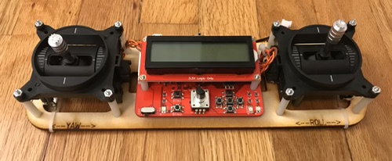
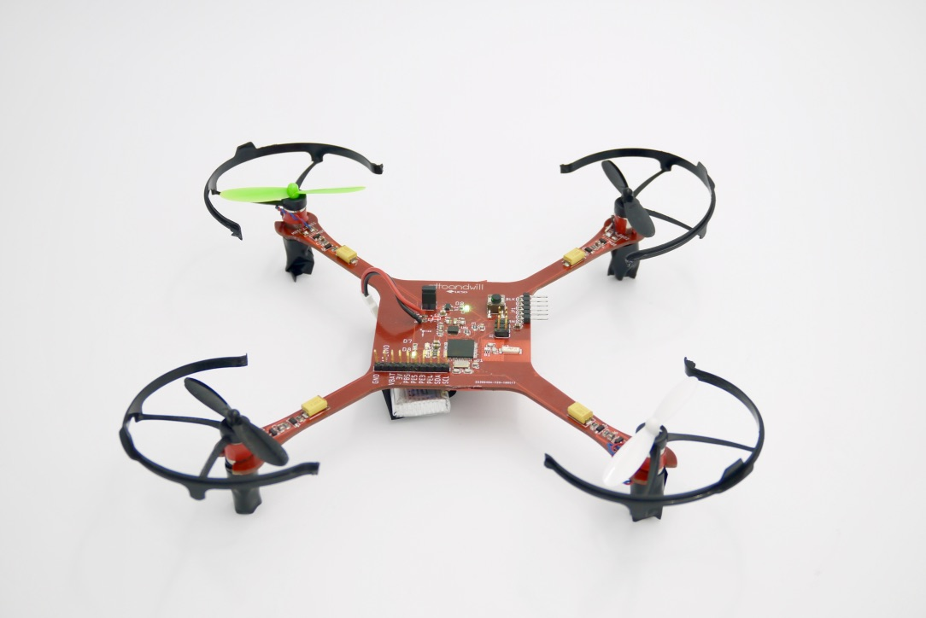
Our Project
Motors
IMU
Radio
Flight control software

Slide 37
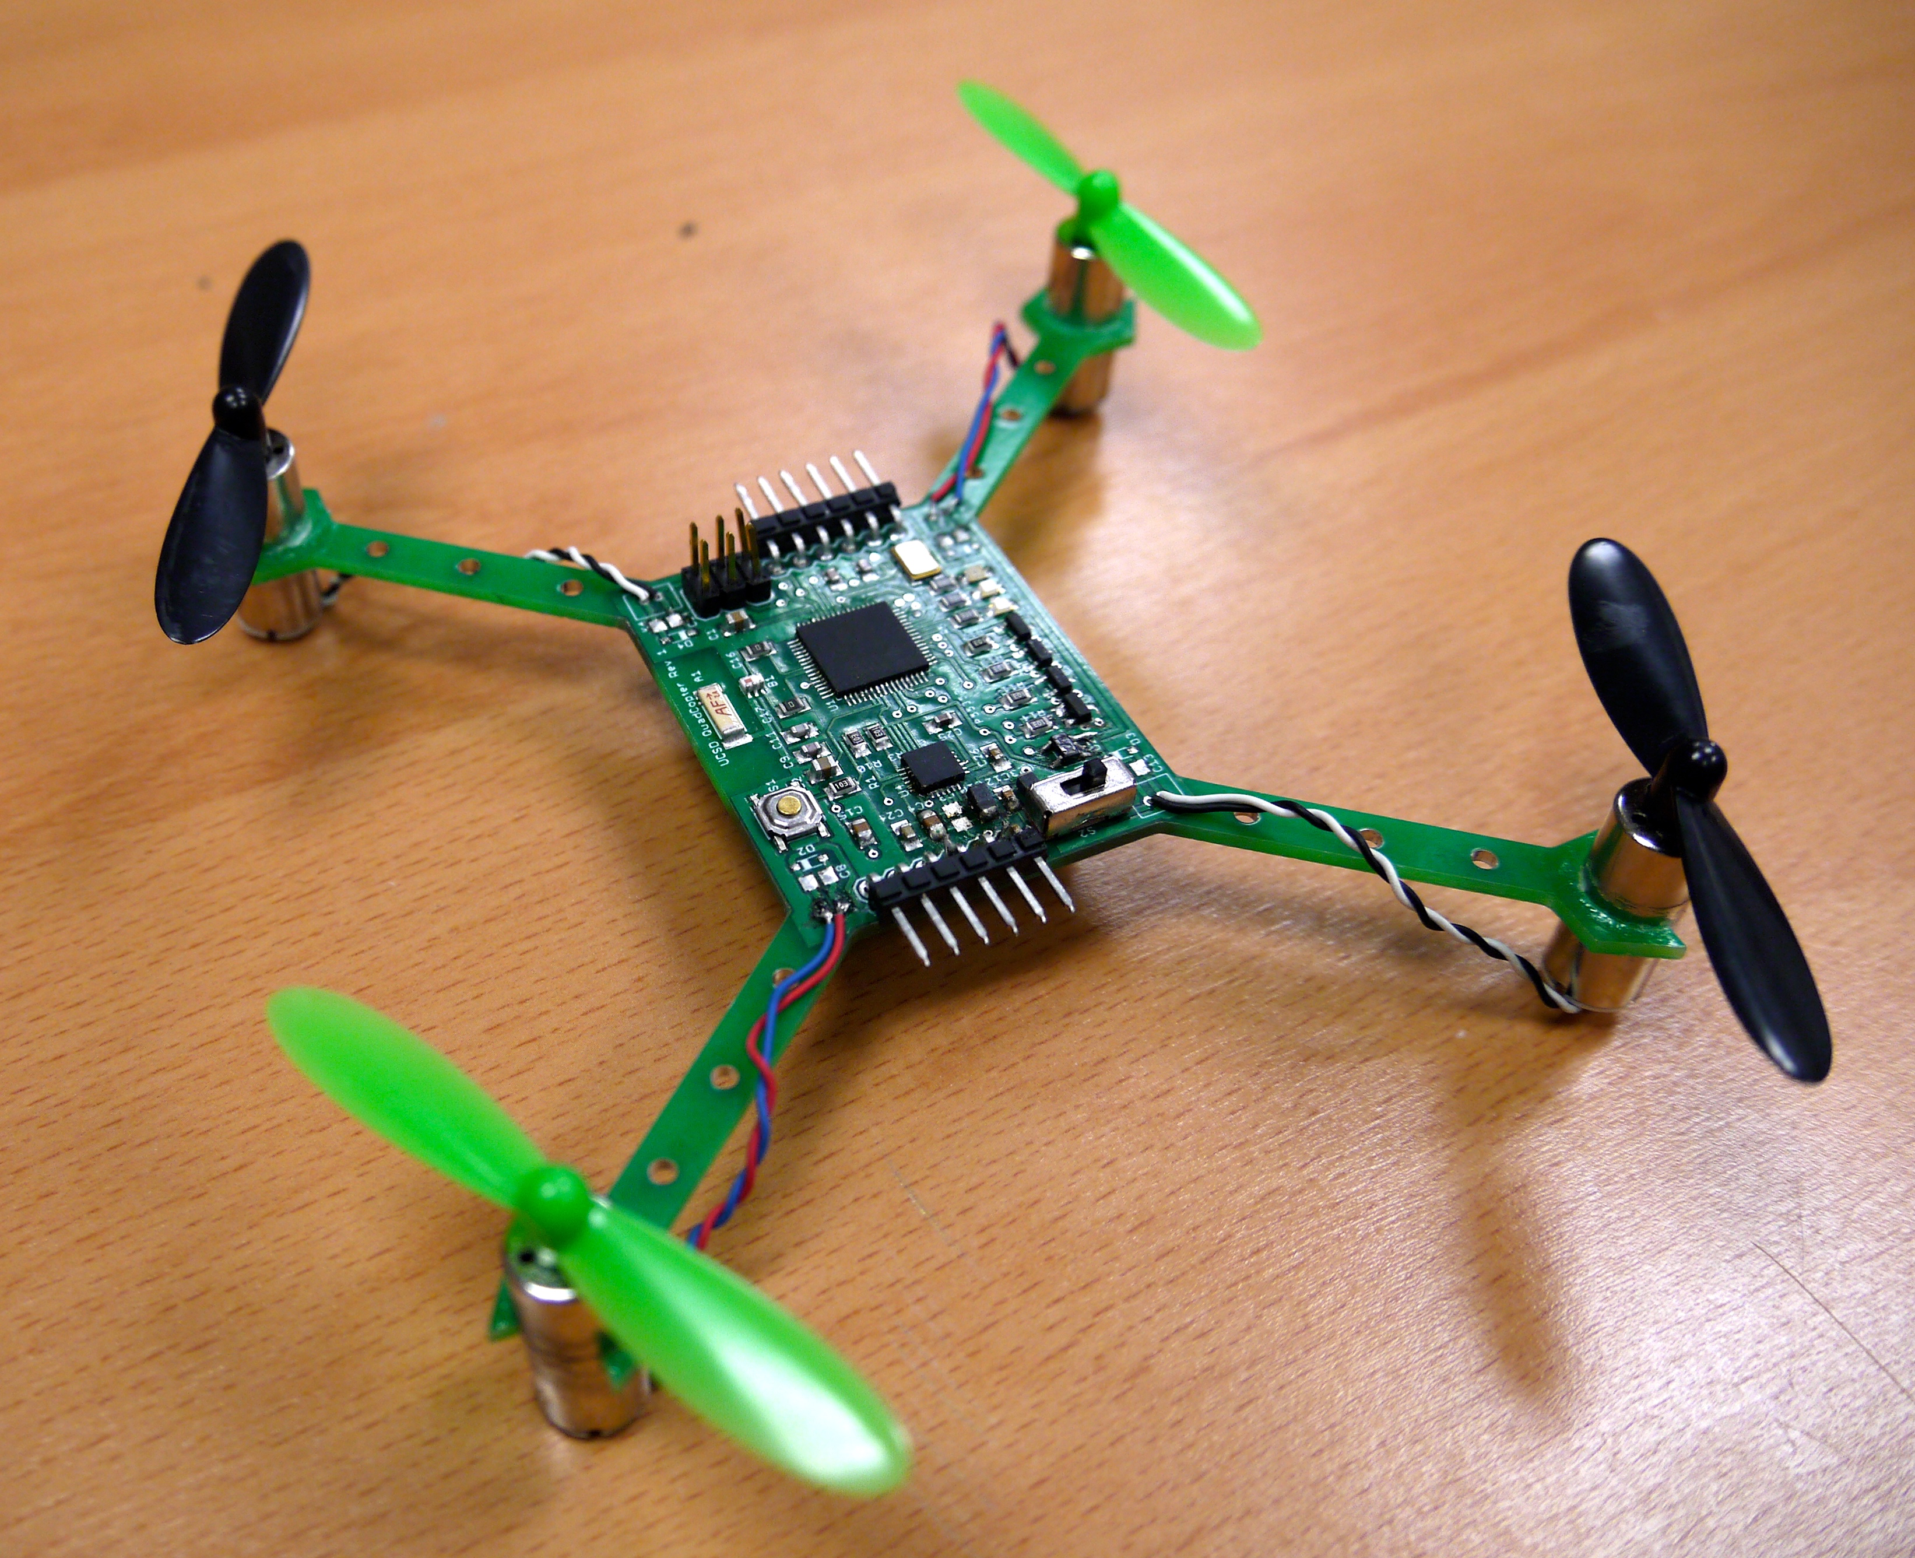
The Hardware You will Build

Slide 38
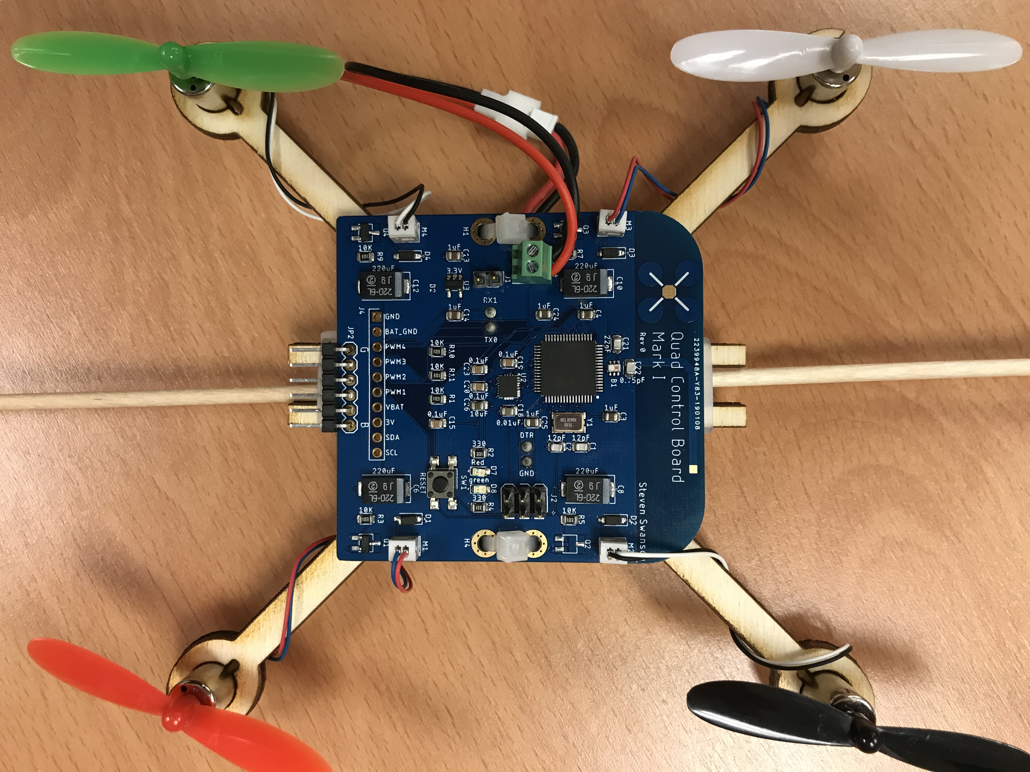
The Hardware You Will Build

Slide 39
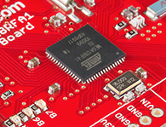
Flight Computer: ATmega128RFA1 microcontroller
Arduino compatible
16Mhz clock
128KB Flash
16KB SRAM
4096B EEPROM
2.4GHz radio

Slide 40
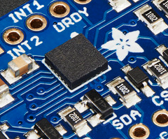
Inertial Measurement Unit
STMicro LSM9DS1
9-axis sensor
3-axis accelerometer
3-axis magnetometer
3-axis gyroscope
I2C interface

Slide 41
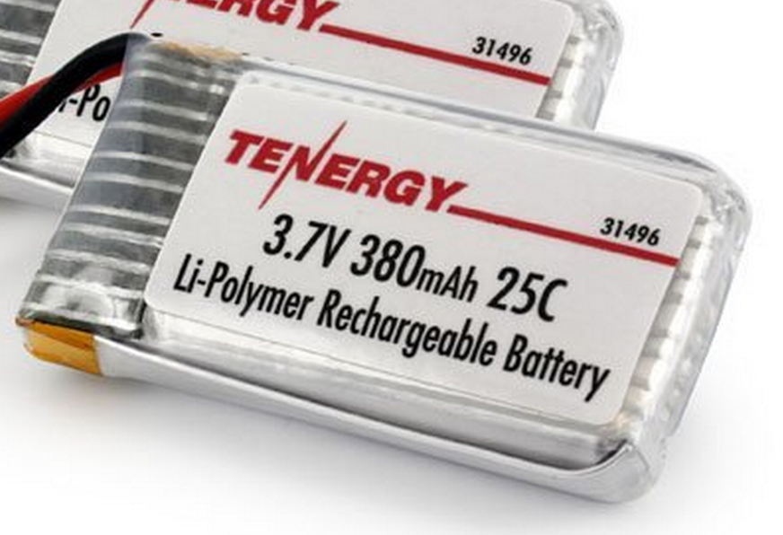
Power Supply
Lithium Polymer Battery
370-600 mAh
Max Current: 9.25 Amps (a lot!)
Nominal voltage: 3.7-4.2V
Powers the motors directly
3.3V low dropout (LDO) voltage regulator
Powers the microcontroller and the IMU

Slide 42
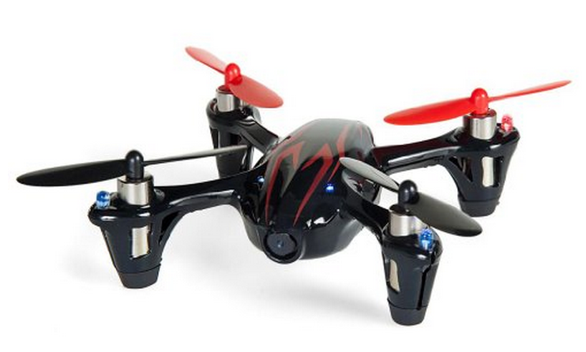
Motors and Props
DC brushed motors
Max current: ~2 Amps
Plenty of power

Slide 44
Building Parts in Eagle Lab Overview
Dr. Steven Swanson
CSE176e/276e
swanson@cs.ucsd.edu

Slide 45
The Parts You Will Build
Resistor
LED
MOSFET
IMU

Slide 46
Datasheets
Datasheets describe electronic component.
Capabilities
Mechanical information
Size
Recommended board layout
Pin location
Electrical information
Input/output voltages
Additional required components
Schematic Applications
Examples of how to connect the part electrically
Processing information
Reflow soldering requirements
Packaging information

Slide 47
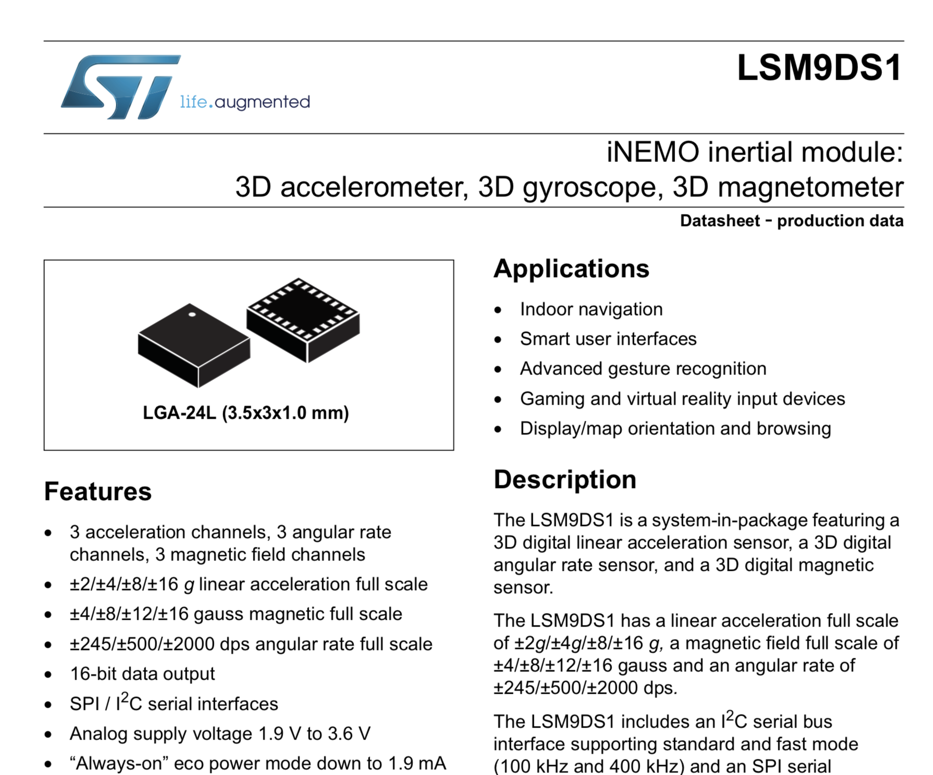

Slide 48
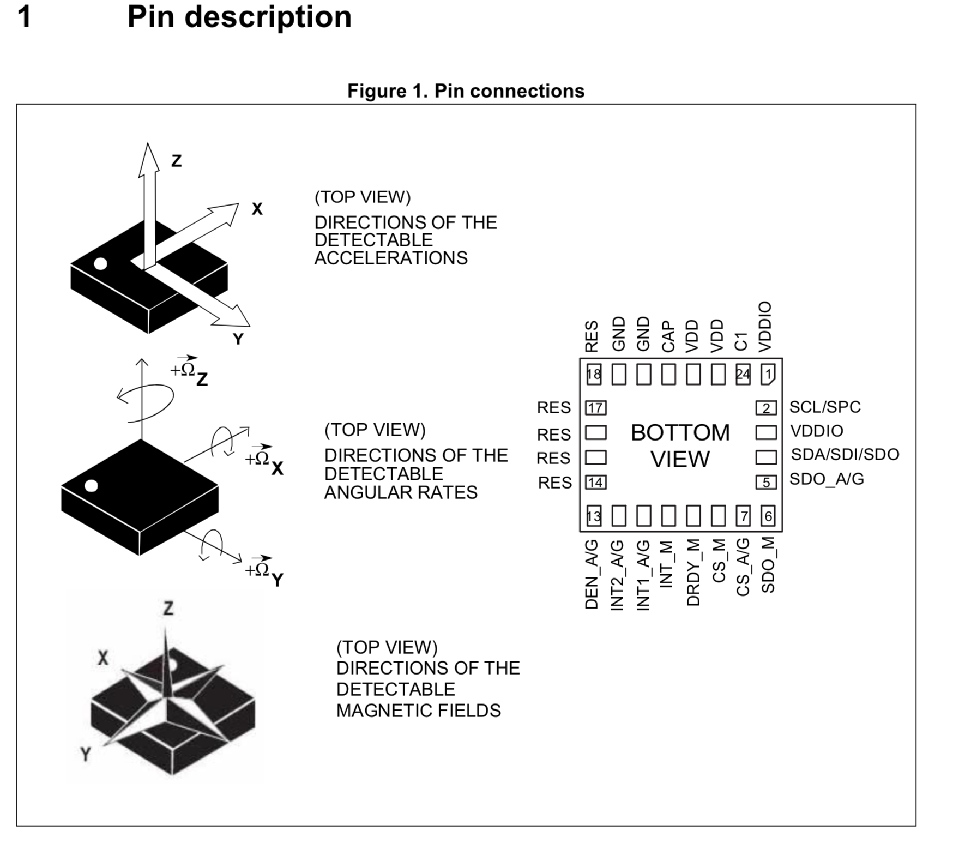

Slide 49
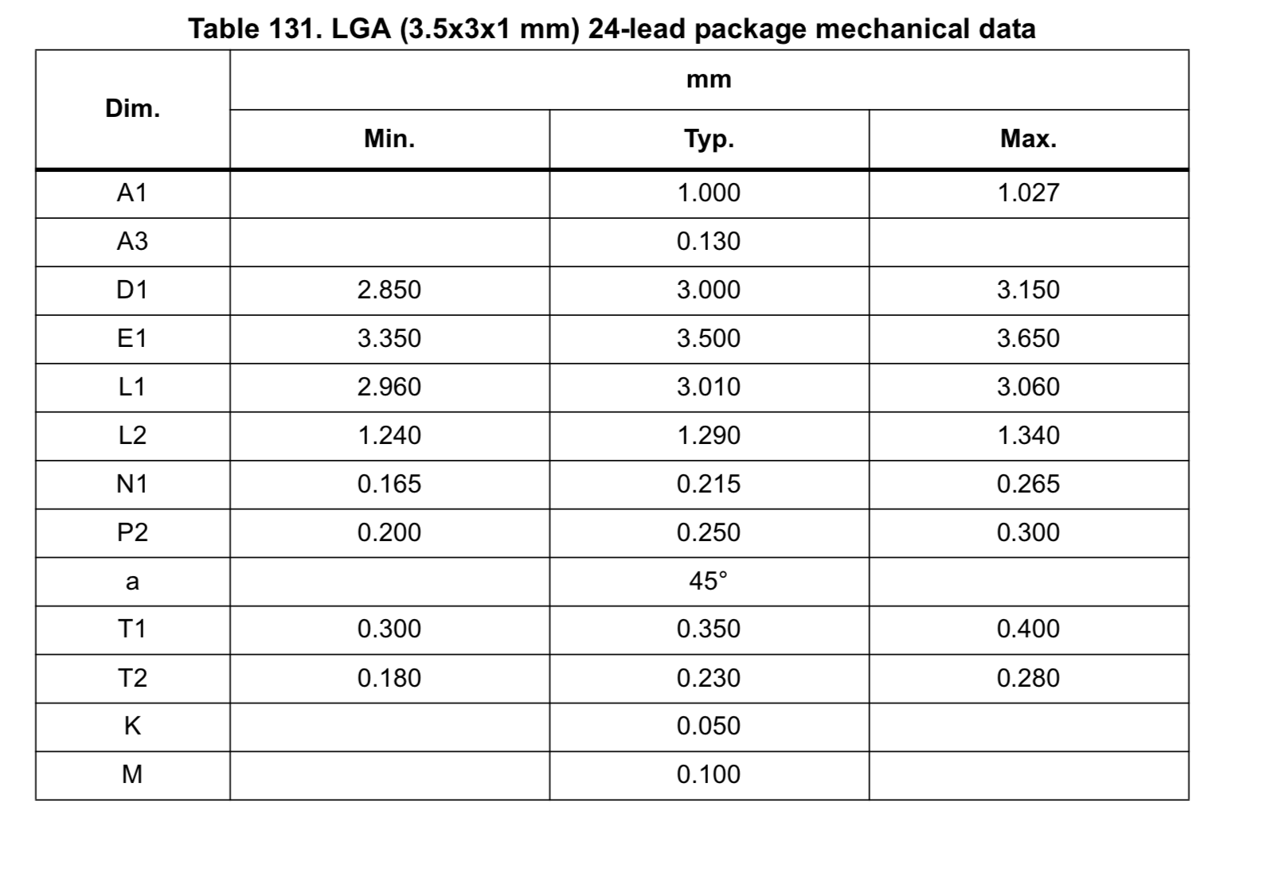
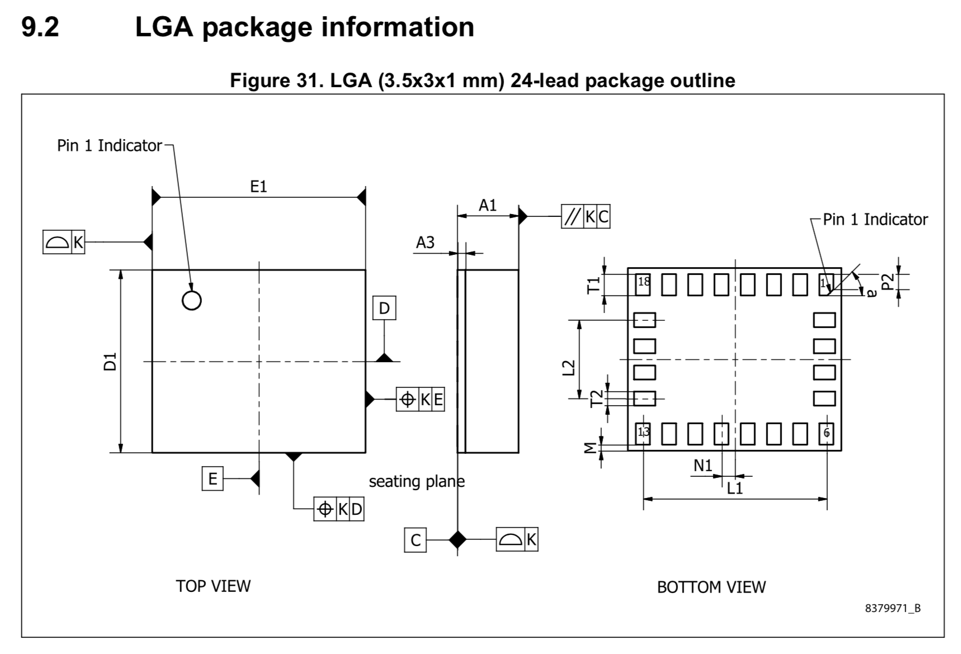

Slide 50
Tech Notes
More detailed information on some aspect of a part.
They will usually be referenced in the data sheet.
Sometimes, you just need to go looking for them.

Slide 51
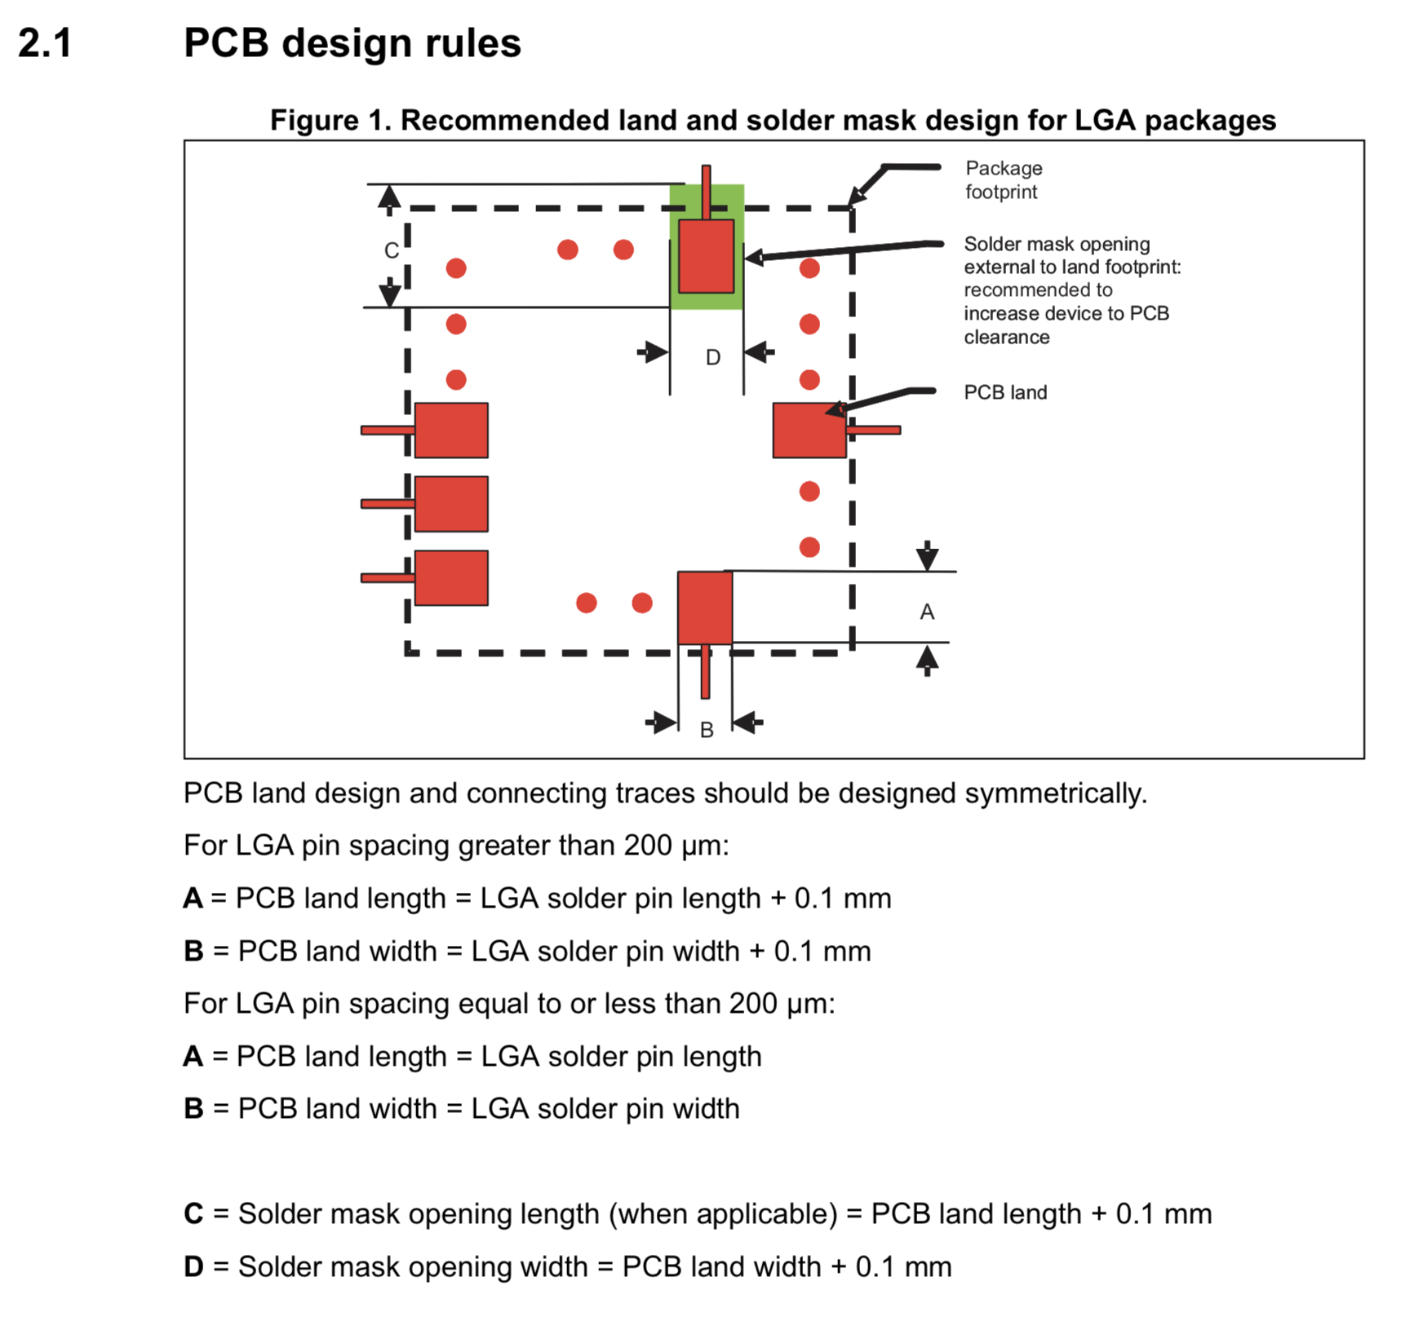
IMU Tech Notes
There are two of them in the Datasheet directory.
IMU_*
One is about LGA soldering
The other is about soldering sensors in particular.
Read them!

Slide 52
MOSFET
An electrically controlled switch
It controls the large currents to the motors
Symbol
It’s an NMOS transistor
Use google to find an appropriate symbol
Make sure you get the source and drain correct (follow the datasheet)
Package
We need large metal pads for thermal reasons
But small bits of exposed metal for soldering
Pads with large metal/small solder mask opening

Slide 53
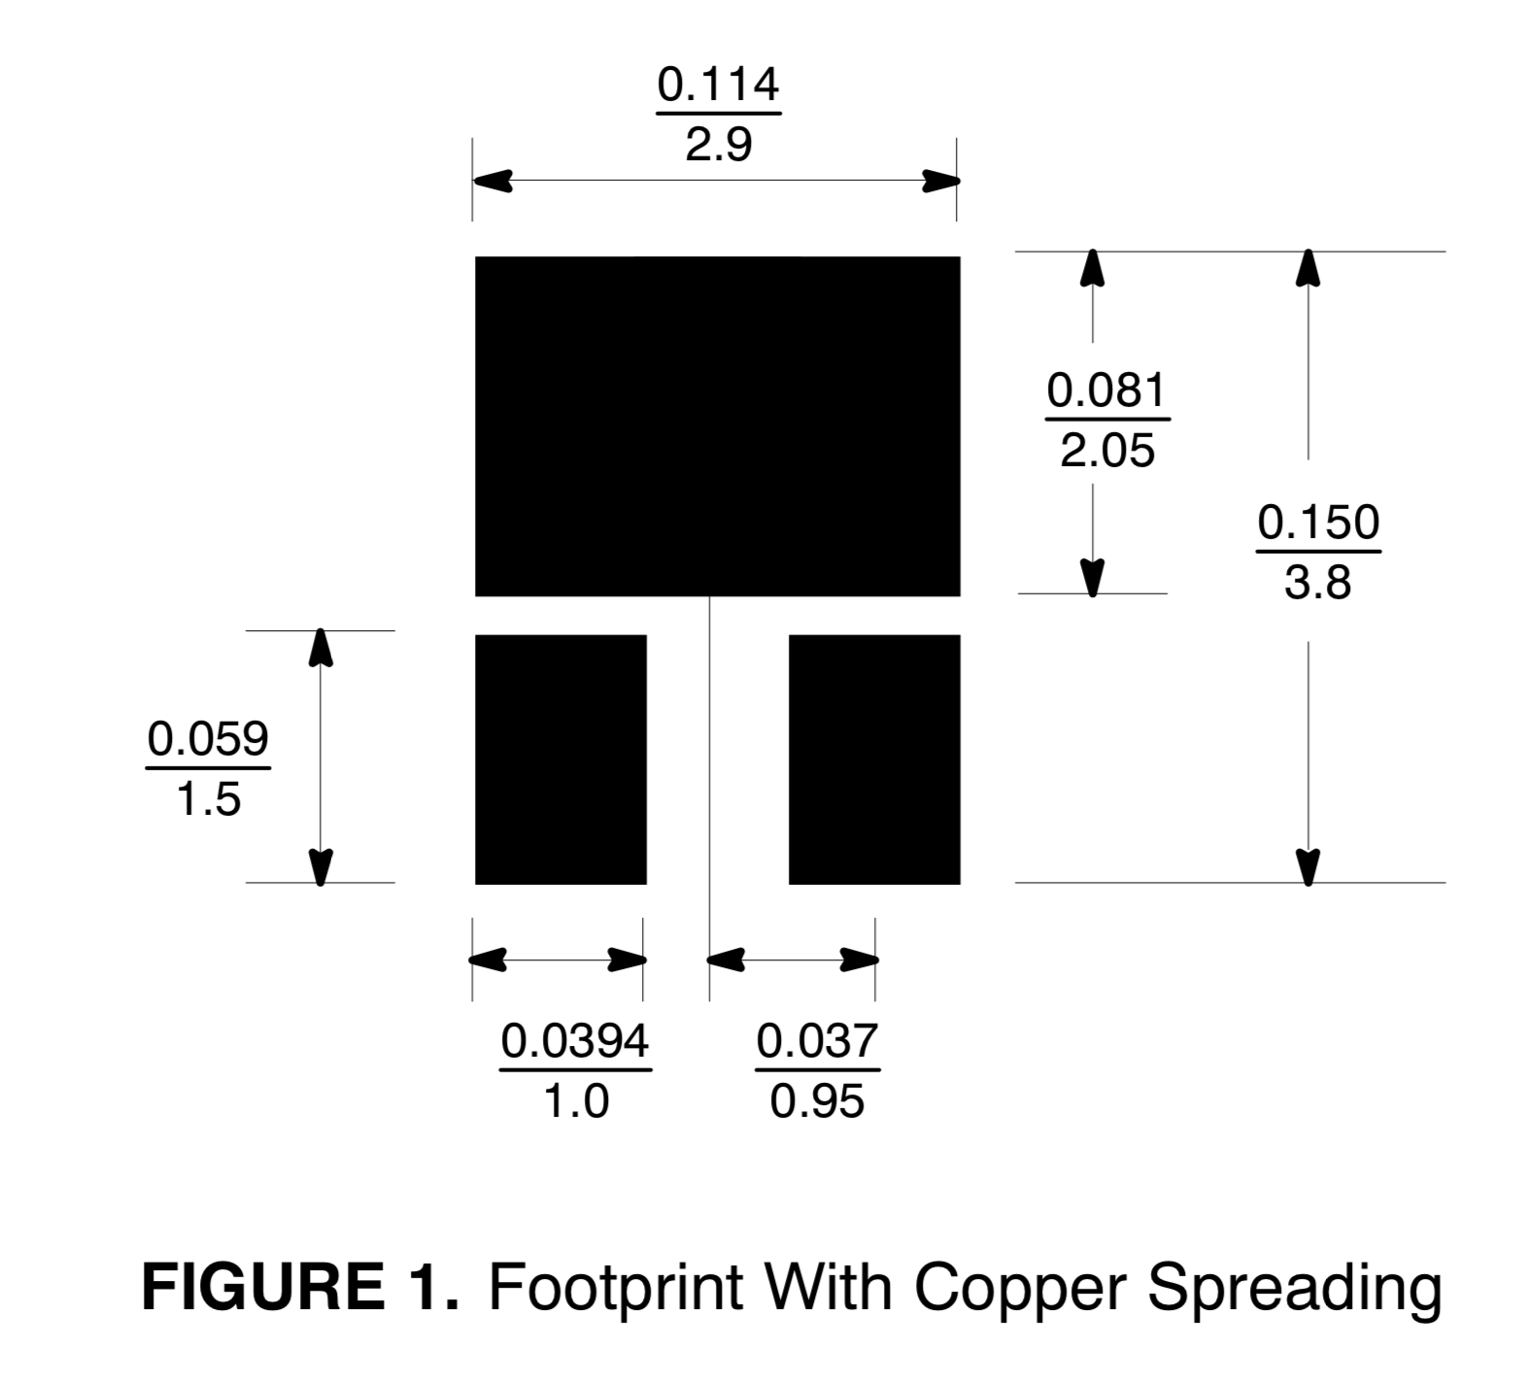
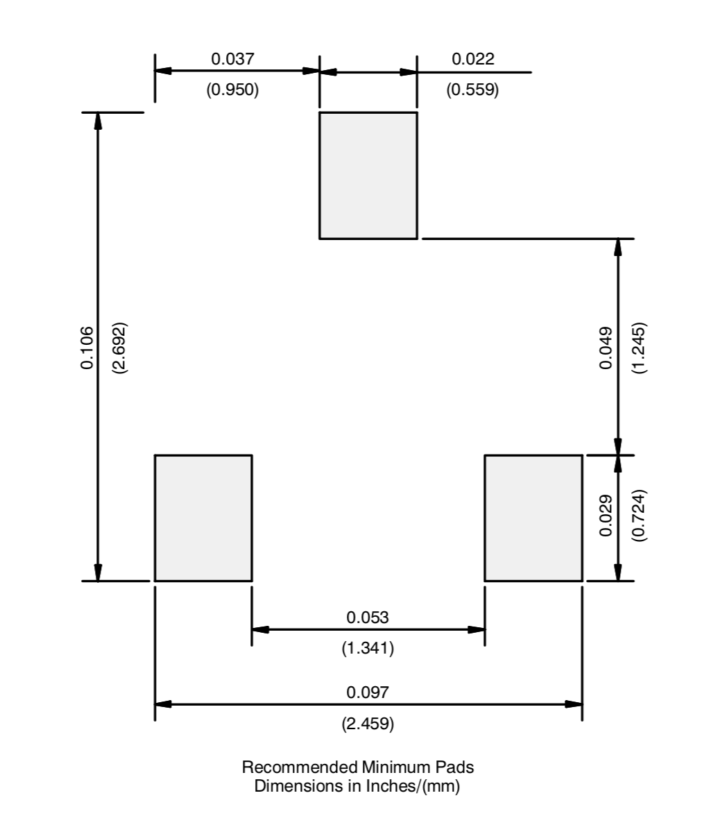
MOSFET Pad guidance in the datasheet
Metal pads
Solder mask openings

Slide 54
The LEDs
You will design your LED from scratch!
Draw an appropriate symbol (look online for examples)
Pay careful attention to orientation.
Do not confuse the cathode and the anode
Correct orientation should be clear on the schematic symbol and the package.

Slide 55
Questions?

Slide 56
Demo and Lab Walk Through
MOSFET
Symbol
Package
Device
IMU
Symbol
Package
Device

Slide 57
Next time
Lecture was about 30 minutes of questions + 1 hour of new material.

Slide 58
Building a PCB Footprint Demo
Dr. Steven Swanson
CSE176e/276e
swanson@cs.ucsd.edu

Slide 59
Building a PCB Schematic Symbol Demo
Dr. Steven Swanson
CSE176e/276e
swanson@cs.ucsd.edu

Slide 60
Building a PCB Device Demo
Dr. Steven Swanson
CSE176e/276e
swanson@cs.ucsd.edu

